Slide 1
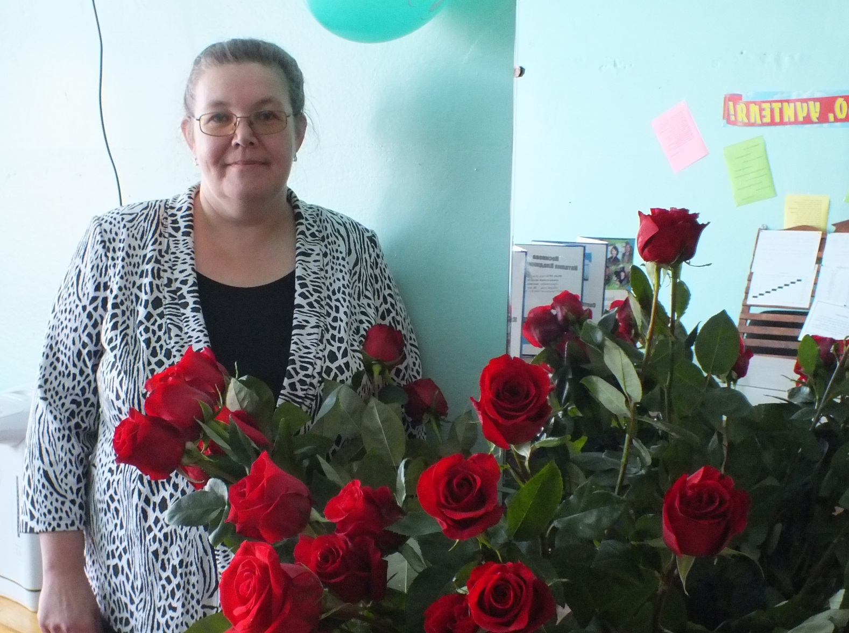
I am Zelenina Natalya Petrovna, an English teacher in a secondary school №1in Balagansk

Slide 2
Education is a life-long process. That’s why I try to help children become independent.
Independent learners are motivated to learn, understand how they learn, are willing to make an effort for learning.
They are able to use learning strategies according to their needs.
They can monitor the process taking decisions and making choices.

Slide 3
Teachers open the door. You enter by yourself. (Chinese proverb)
Anyone who has made a mistake, has never tried anything new. (Albert Einstein)
The most basic of all human needs is the need to understand and to be understood. The best way to understand people is to listen to them. (Ralph Nichols)

Slide 4
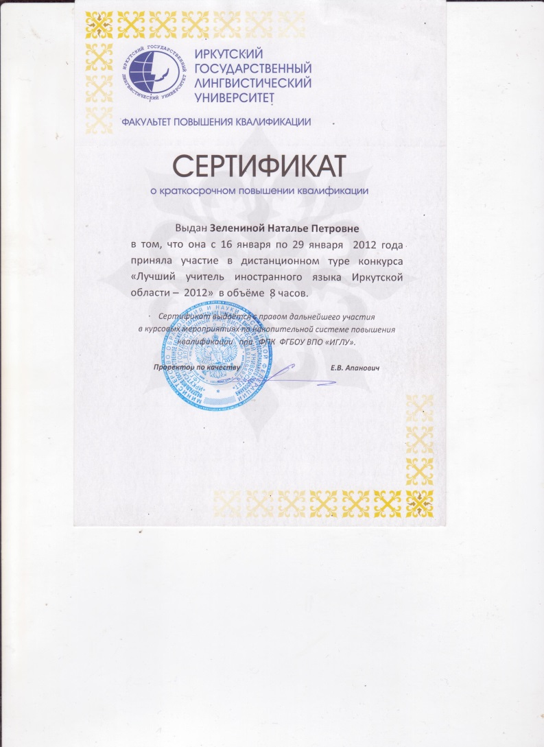
MY WORK

Slide 5
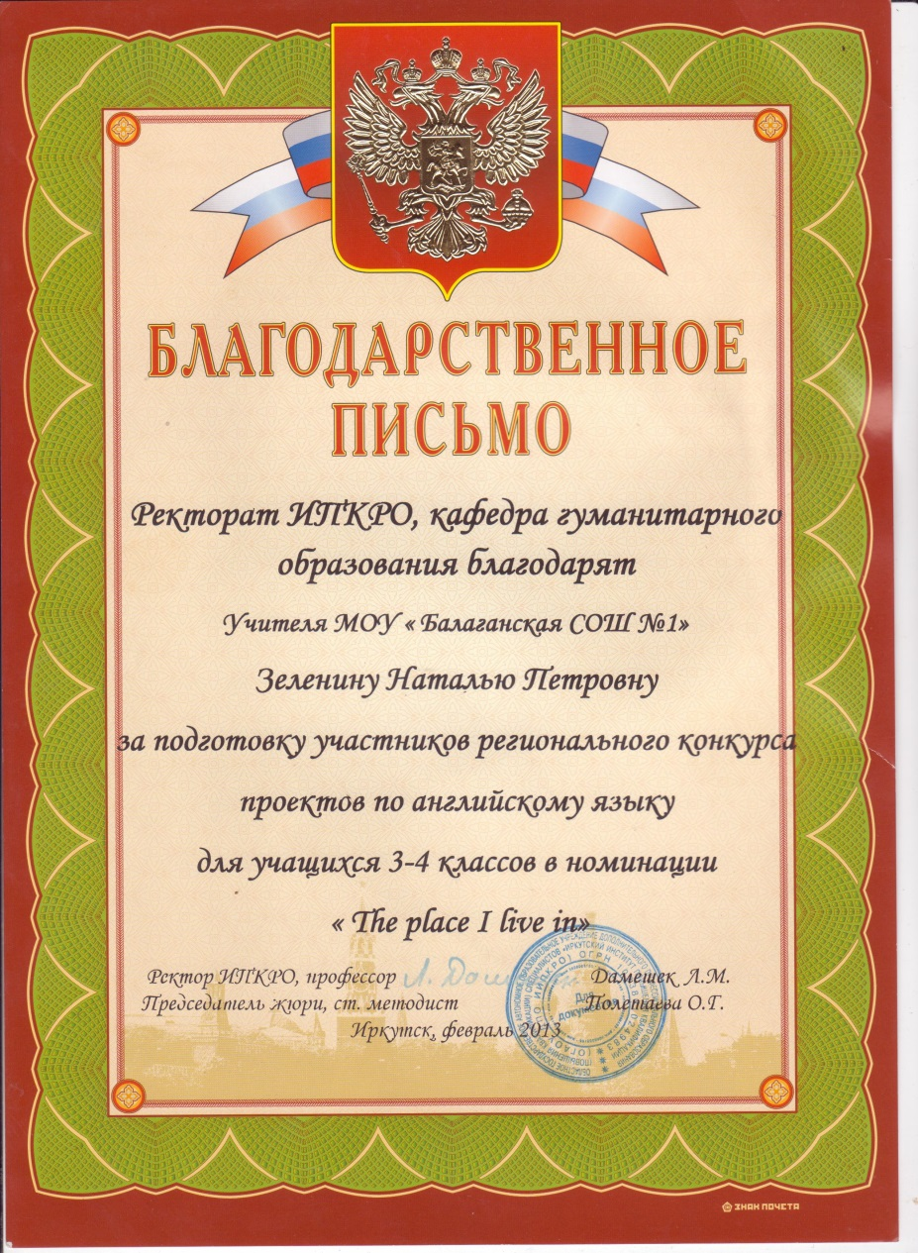

Slide 6
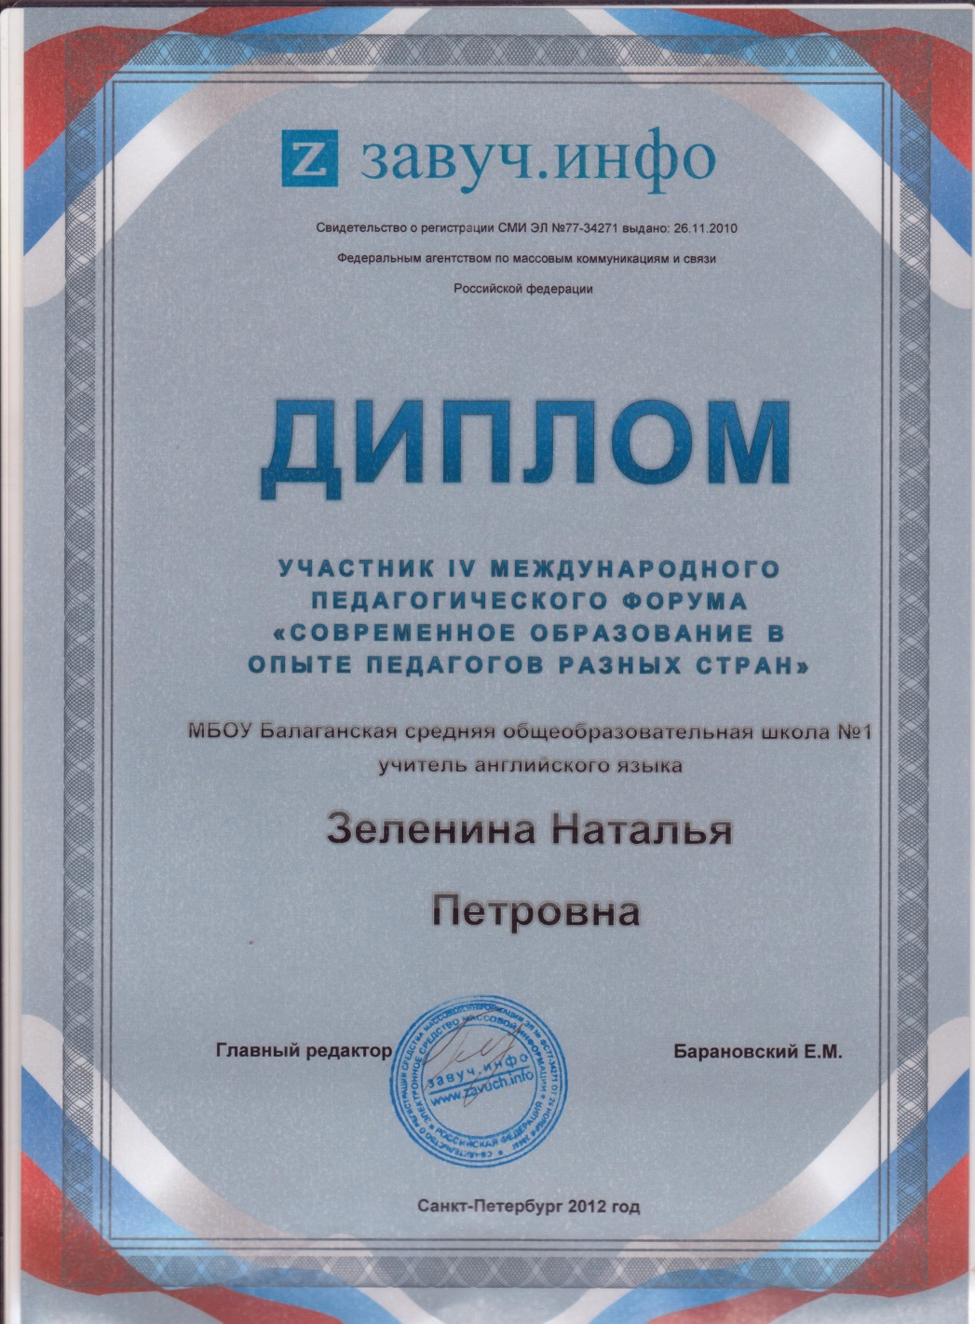

Slide 7
