Slide 1
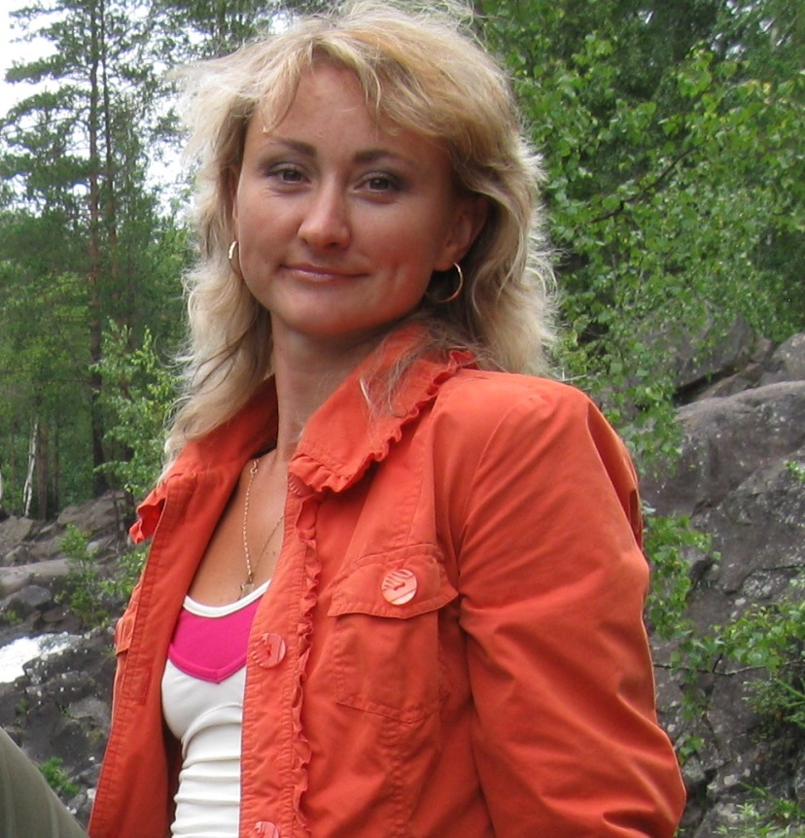
A Few Words about Myself

Slide 2
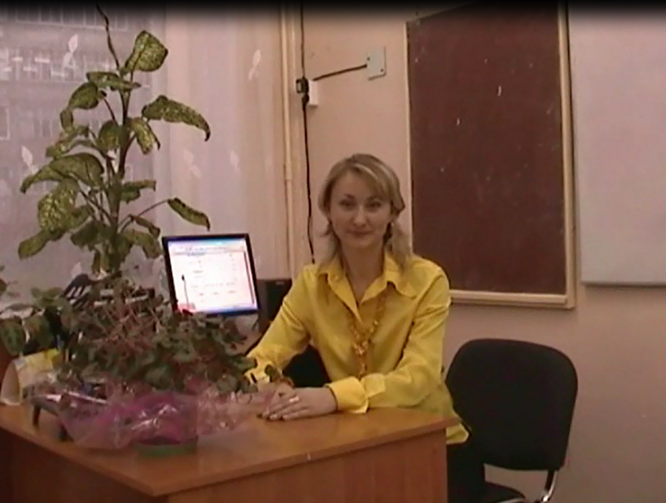
I am English teacher. My name is Natalya Urzhumtseva. I live in small town Vyatskie Polyany, Kirov region, which lies on the bank of the river Vyatka. In 1994 I graduated from Kirov State Pedagogical Institute by V.I. Lenin.

Slide 3
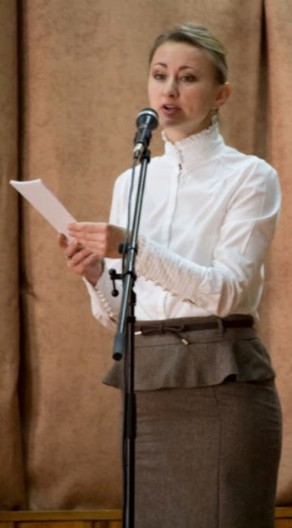
I continue learning and looking for new ideas and different ways to present my lessons. I with my pupils often take part in different English competitions and projects.
Besides teaching I`m keen on travelling.
My motto: Men learn while they teach.

