Slide 1
БОУ «Вохтожская средняя общеобразовательная школа №2»
Интерактивный тест по теме
«New York, New York»
Автор-составитель:
Воротина Лилия Александровна,
учитель английского языка высшей категории
Start
Вохтога, 2011

Slide 2
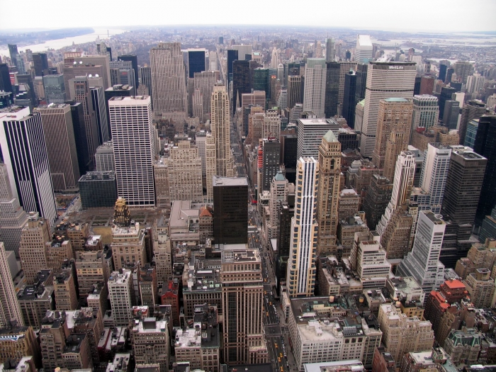
1) What is another name of New York?
America’s Big City
America’s Big Orange
America’s Big Apple

Slide 3
Well done!

Slide 4
Try again!

Slide 5
2)What is the most famous symbol of America?
The Statue of Liberty
The Hudson
The Chrysler
Help!!!

Slide 6
Well done!

Slide 7
Wrong!

Slide 8
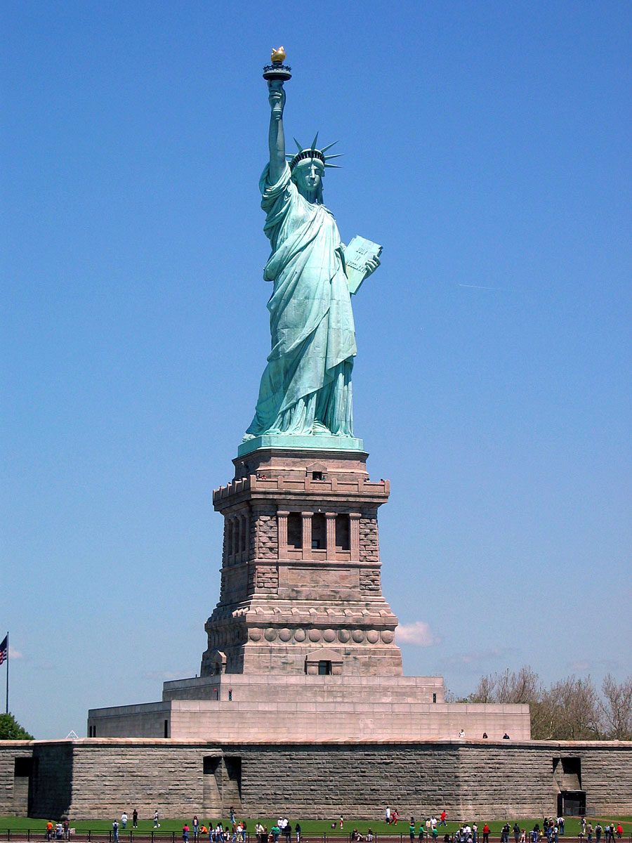
What is it?

Slide 9
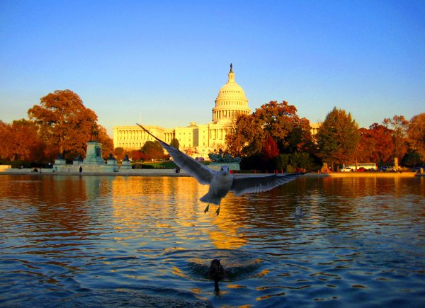
3) Where is New York?
on the River Thames
on the River Hudson
on the Potomac River

Slide 10
Well done!

Slide 11
Wrong!

Slide 12
4)What building became the tallest skyscraper in New York in 2001?
Empire State Building
The Chrysler
The Rockefeller Center
Help!!!

Slide 13
Well done!

Slide 14
Try again!

Slide 15
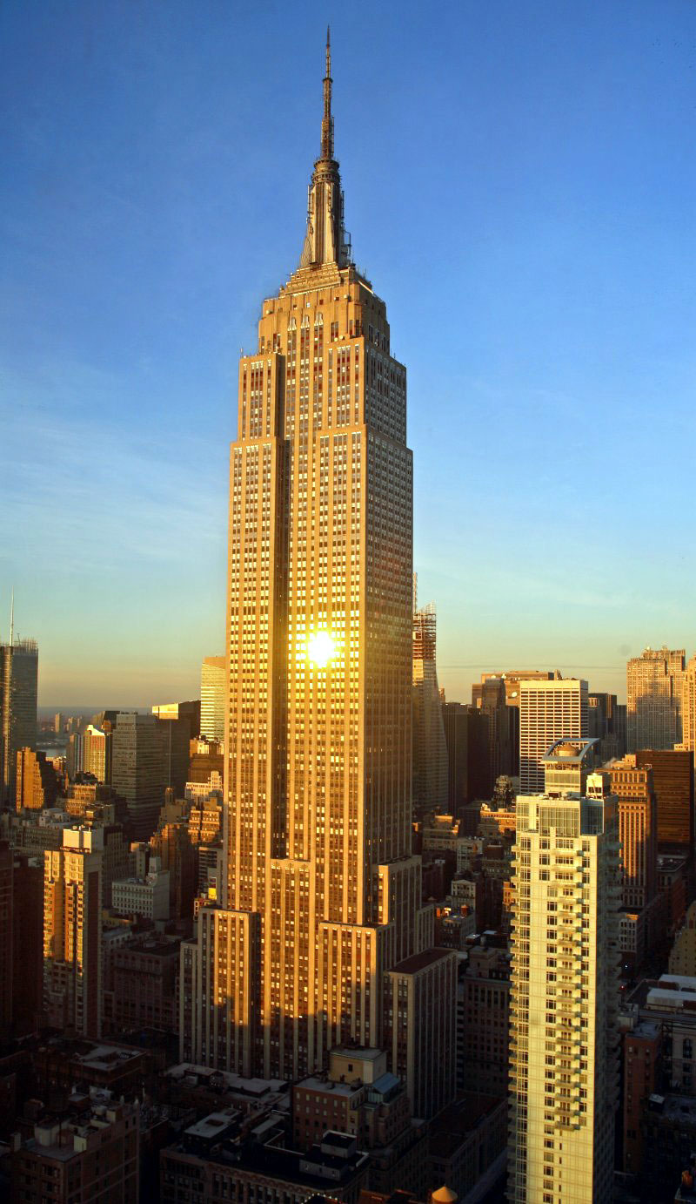
What is it?

Slide 16
5) What is Rockefeller Center Famous for?
a) beautiful statues
b) Christmas trees
c) famous theatres
Help!!!

Slide 17
Well done!

Slide 18
Try again!

Slide 19
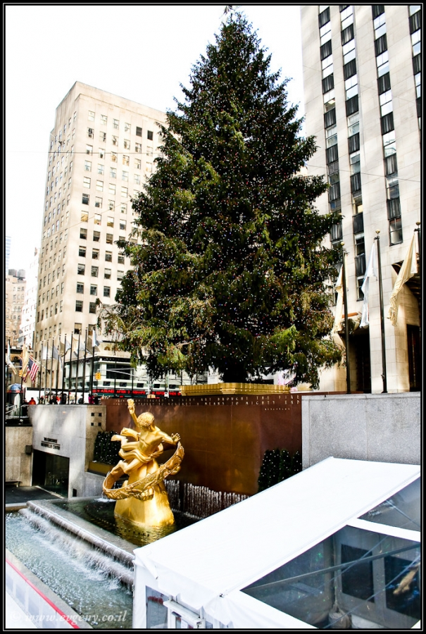
What is it?

Slide 20
6) What is Broadway famous for?
shopping centers
cinemas
theatres
Help!!!

Slide 21
Well done!

Slide 22
Wrong!

Slide 23
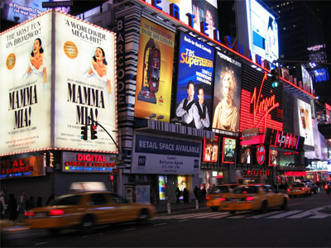
What is it?

Slide 24
7) Who designed the Guggenheim Museum?
a) Frank Lloyd Wright
b) Oliver Cromwell
c)John D. Rockefeller
Help!!!

Slide 25
Well done!

Slide 26
Wrong!

Slide 27
Who is it?

Slide 28
8)What is the heart of New York?
Brooklyn
Manhattan
Staten Island
Help!!!

Slide 29
Well done!

Slide 30
Wrong!

Slide 31
What is it?

Slide 32
9) Name 5 boroughs of New York
Manhattan
Brooklyn
Times Square
Nevada
Beverly Hills
Staten Island
the Bronx
Queens

Slide 33
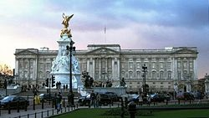
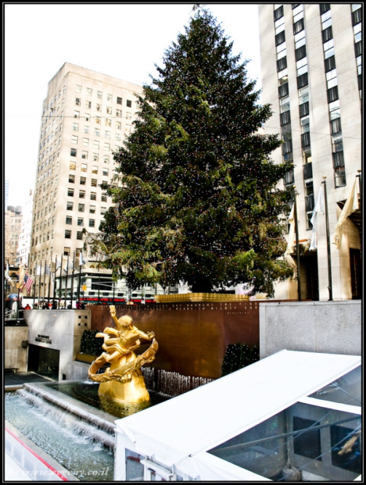
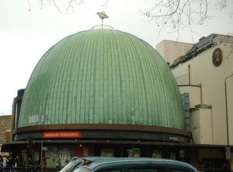
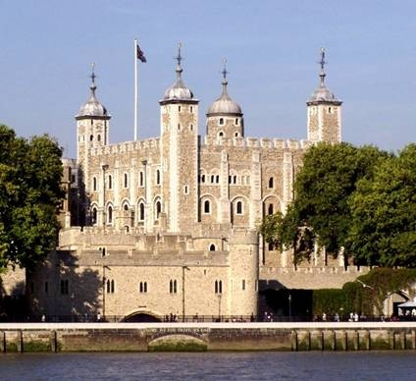
10)What sights are in New York?

Slide 34
Your results
No mistakes - «Excellent»
1-2 mistakes - «Very good»
3-4 mistakes - «Good»
5 -6 mistakes - « Satisfactory»
More than 6 mistakes - « Try again»

Slide 35
Список источников основного содержания
Кауфман К., Кауфман М. УМК «Happy English. Ru » для 9 класса. – Титул, 2008

Slide 36
Источники изображений
http://www.newyorkinfo.ru/gallery/obshhie_vidy/foto_30.html
http://www.liveinternet
http://rusdatas.ru/publ/interesnoe_v_fotografijakh/bolshie_smajly
http://mysmiles.ru/index-20.php&usg
http://office.microsoft.com/ru-ru/training/CR010065457.aspx
http://www.orangesmile.com/destinations/new-york/index.htm
http://nickfriend.livejournal.com/
http://www.rudata.ru/wiki/
http://www.evgeny.co.il/foto/view-to-americ-rockefeller-center

