Slide 1
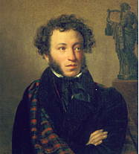
THE MONUMENTS TO ALEXANDER PUSHKIN
IN RUSSIA
Работу выполнила
ученица 6 А класса
МБОУ КСОШ № 19
Лепшина Анастасия
Учитель Дзгоева Д.Г.

Slide 2
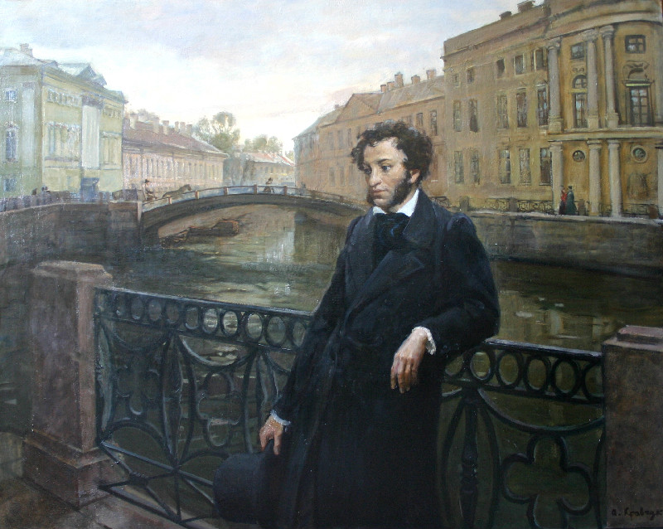
A monument I've raised not built with hands, And common folk shall keep the path well trodden To where it unsubdued and towering stands Higher than Alexander's Column. (A.S.Pushkin)

Slide 3
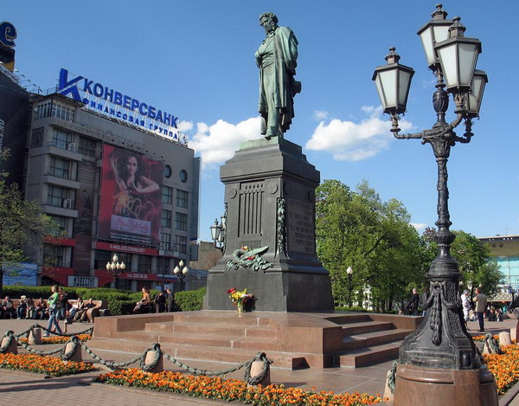
The monument in Pushkin square in Moscow

Slide 4
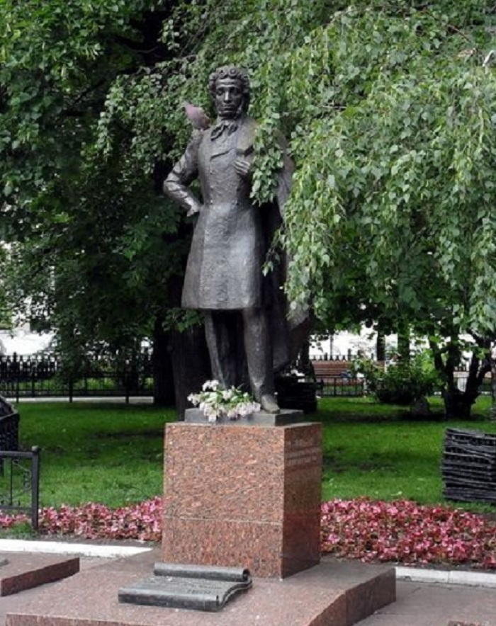
The monument in the
Old Arbat Street
in Moscow.

Slide 5
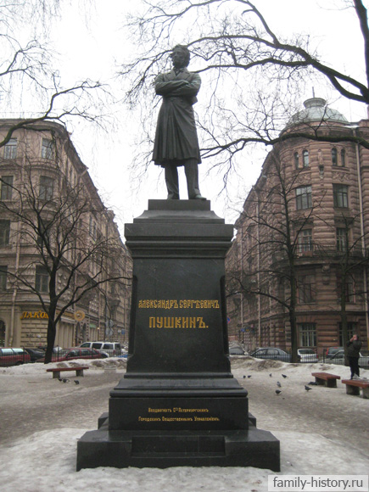
Monument in the Pushkinskaya street in Saint-Petersburg
The sun of our poetry is down! Pushkin passed away, passed in the flower of his age, in the middle of his great endeavor!... To speak more of it we do not have the power, and there is no need to do so; every Russian heart knows the whole price of this irrecoverable loss, and every Russian heart will be torn apart.
A. A. Kraevsky

Slide 6
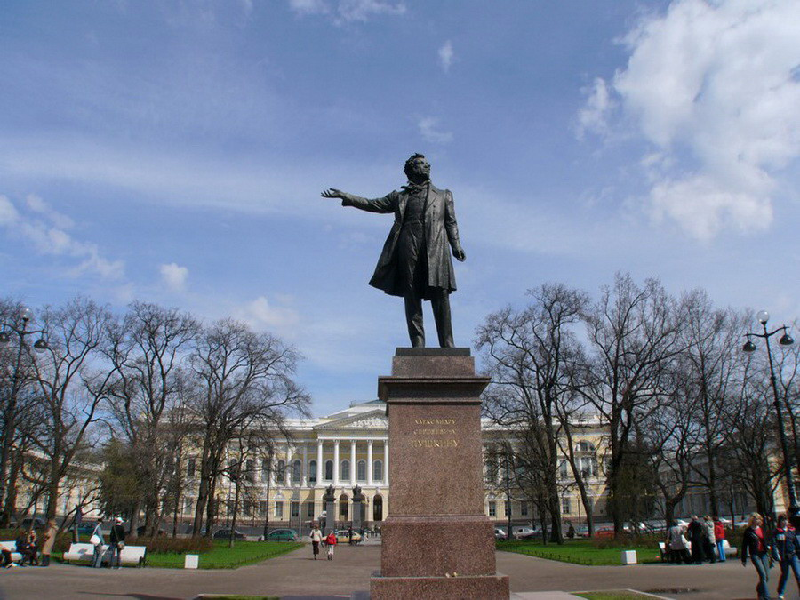
Monument at the Petrovsky square (Square of arts) in St. Petersburg

Slide 7
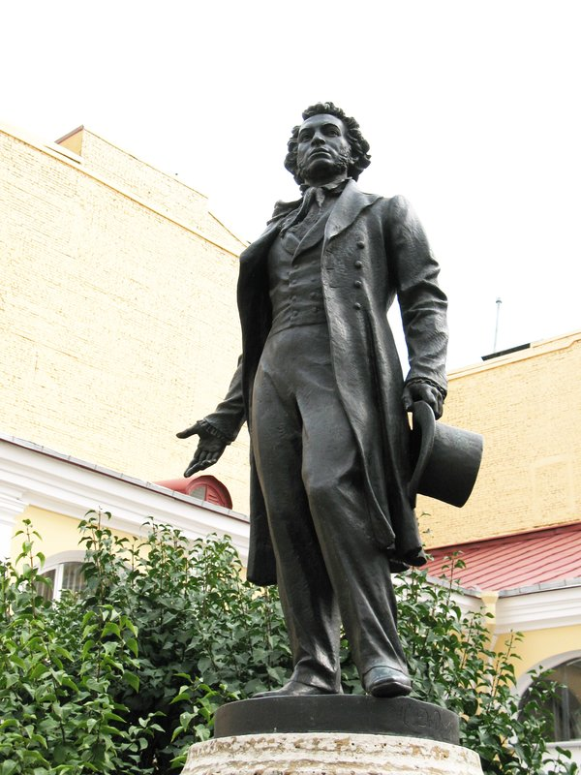
Monument in the Moyka street in Saint-Petersburg
To My Nanny
Dear doting sweetheart of my childhood, Companion of my austere fate! In the lone house deep in the wild wood How patiently for me you wait. Alone beside your window sitting You wait for me and blame the clock, While, in your wrinkled hands, your knitting Fitfully falters to a stop. Beyond the crumbling gates the pinetrees Shadow the road you watch so well. Nameless forebodings, dark anxieties, Oppress your heart. You cannot tell What visions haunt you: Now you seem to see..

Slide 8
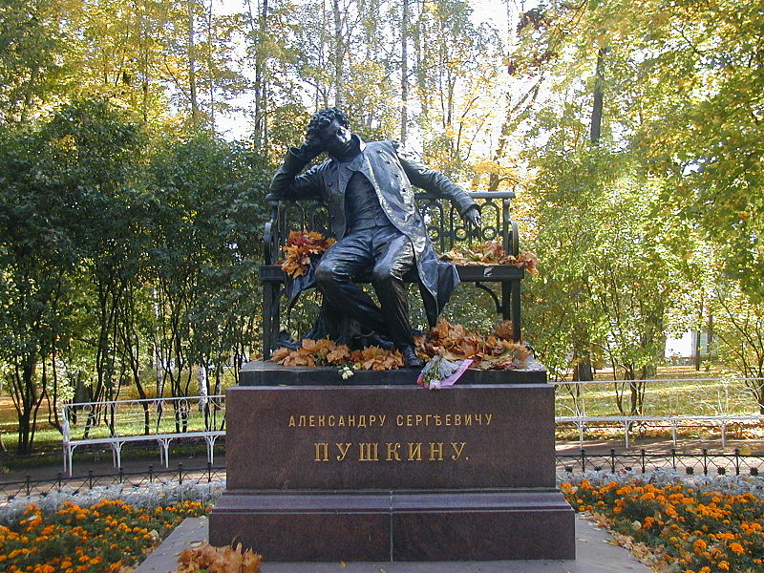
The monument in the town of Pushkin

Slide 9
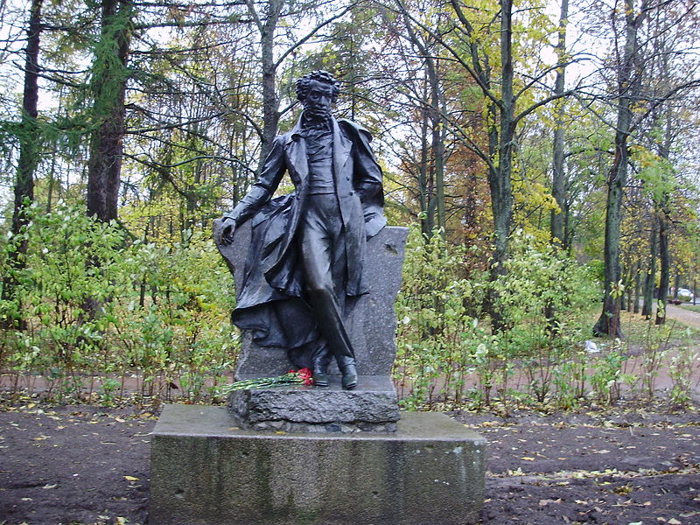
A monument in the town of Pushkin, Oktyabrsky Boulevard

Slide 10
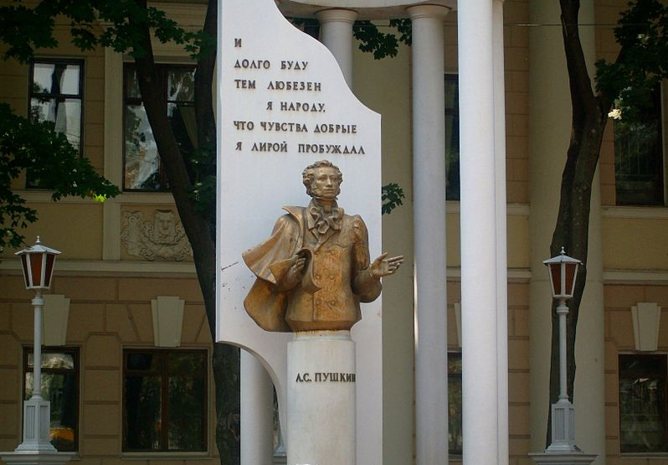
The monument to A. S. Pushkin in Voronezh

Slide 11
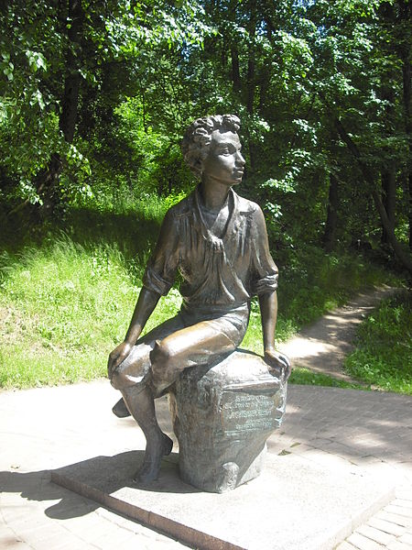
A monument in the estate Zakharovo
To ***
The wondrous moment of our meeting... I well remember you appear Before me like a vision fleeting, A beauty's angel pure and clear.
In hopeless ennui surrounding The worldly bustle, to my ear For long your tender voice kept sounding, For long in dreams came features dear.

Slide 12
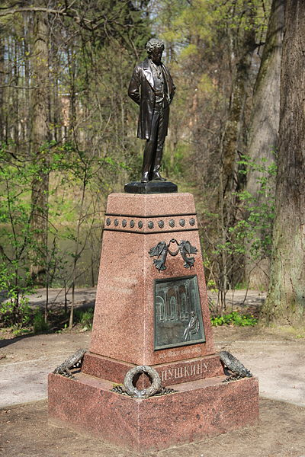
A monument in the Museum-estate Ostafyevo
Storm-cloud
O storm-cloud, the tempest's survival, alone Like mad do you rush o'er the heavenly dome; Alone do you cast as you drift on your way A dark, brooding shade on the jubilant day.
A short while ago you lay cloaking the sky, And great forks of lightning flared round you on high. You thundered and roared over forest and plain And fed thirsting earth with a bounty of rain.
Enough! Make you haste! Do not tarry... Begone! The earth is refreshed, and the rain-storm has flown, And tame though the wind is, it stubbornly tries To make you desert the now radiant skies.

Slide 13
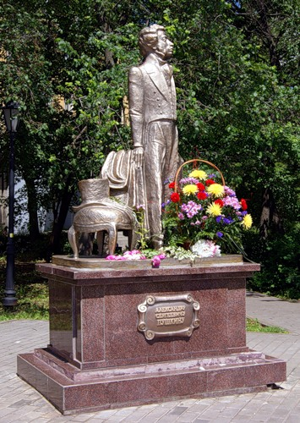
The monument on the corner of the street Nedelin in Lipetsk

Slide 14
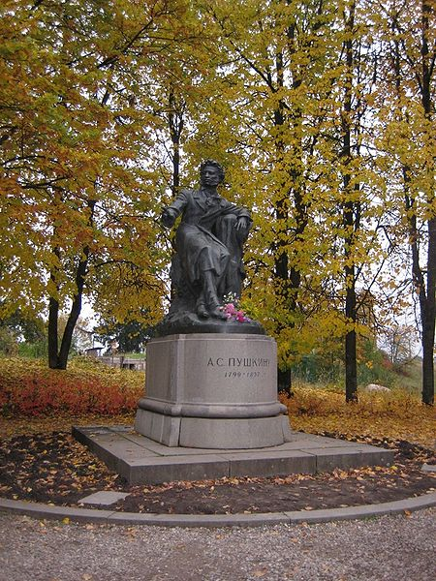
A monument near the Svyatogorsky monastery in Pushkin hills

Slide 15
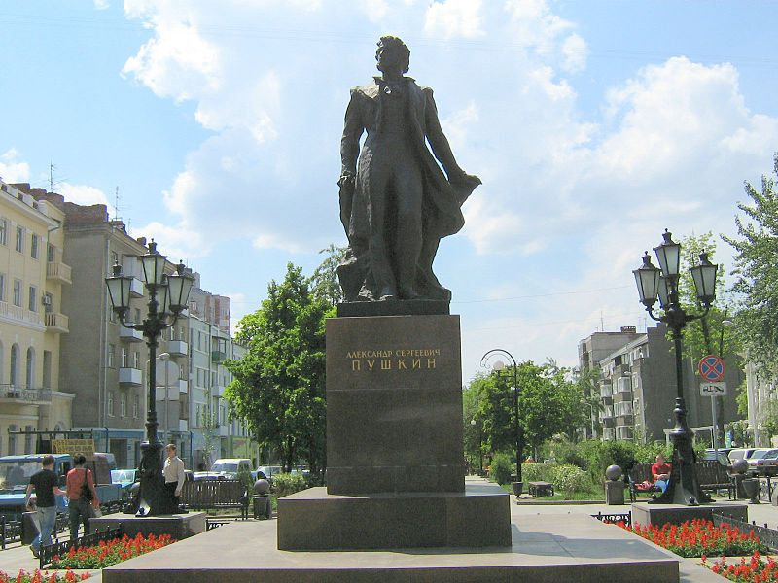
The monument in Rostov-on-Don

Slide 16
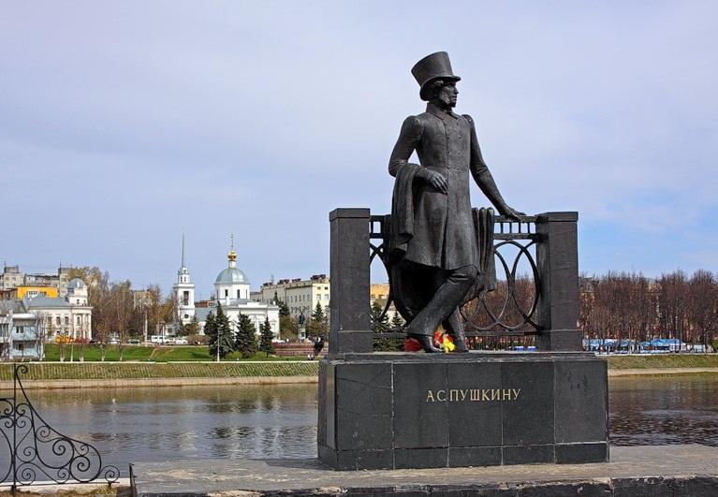
A monument in Tver

Slide 17
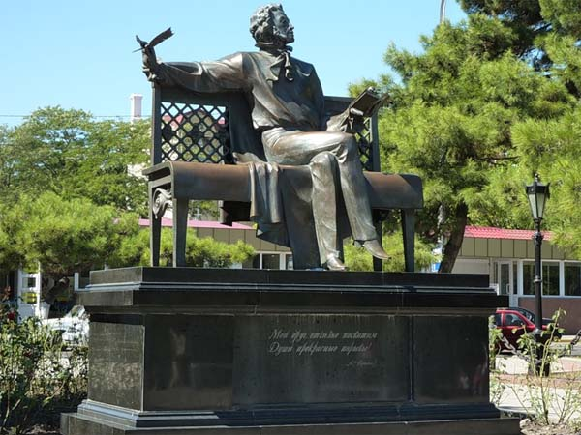
The monument to the poet in Novorossiysk

Slide 18
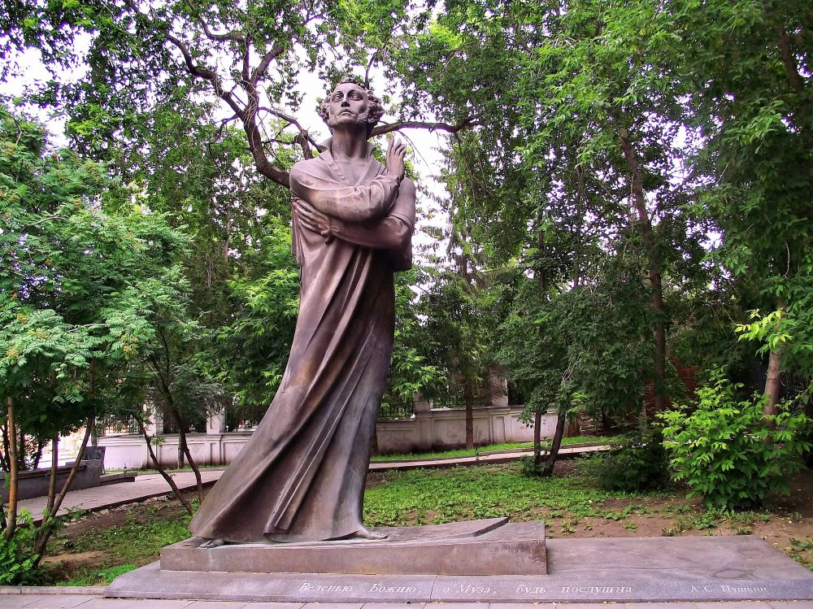
The monument in Yekaterinburg

Slide 19
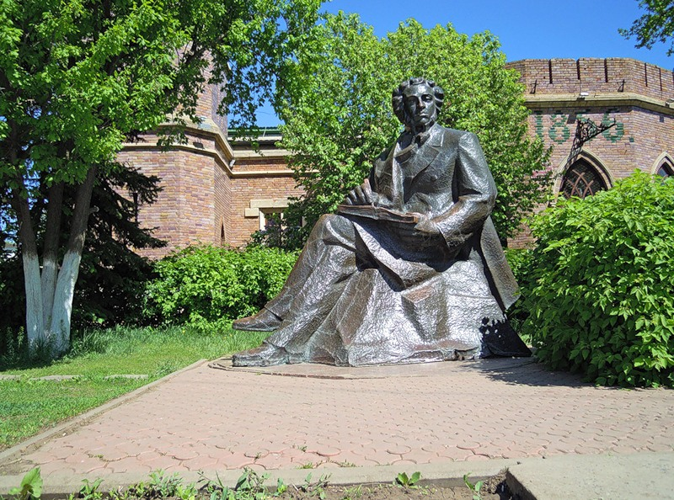
The monument in Orenburg

Slide 20
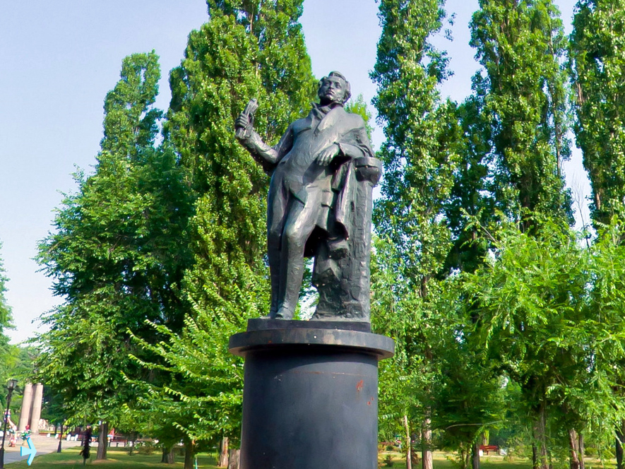
The monument in Taganrog

Slide 21
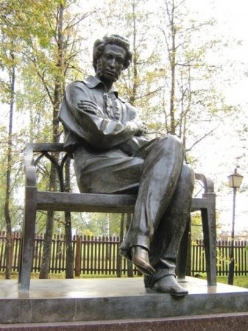
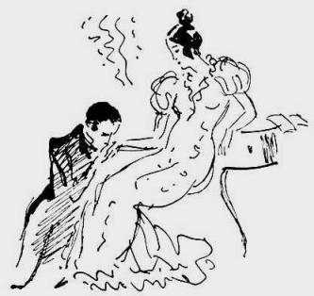
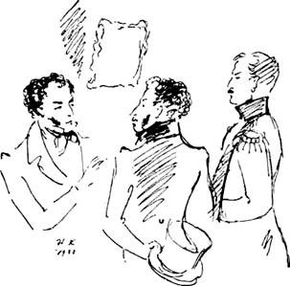
A monument in Arzamas, village Bolshoe Boldino

Slide 22
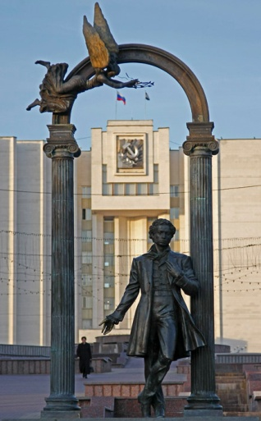
The monument in Saransk
On hills of Georgia lies the covering of night; Aragva streams in front of me. Such sadness and such ease; my melancholy's light, My melancholy's full of thee, Of thee, of only thee... No anxiousness, no pain Unsettles my despondency; My heart again on fire, it burns and loves again, For otherwise it cannot be.

Slide 23
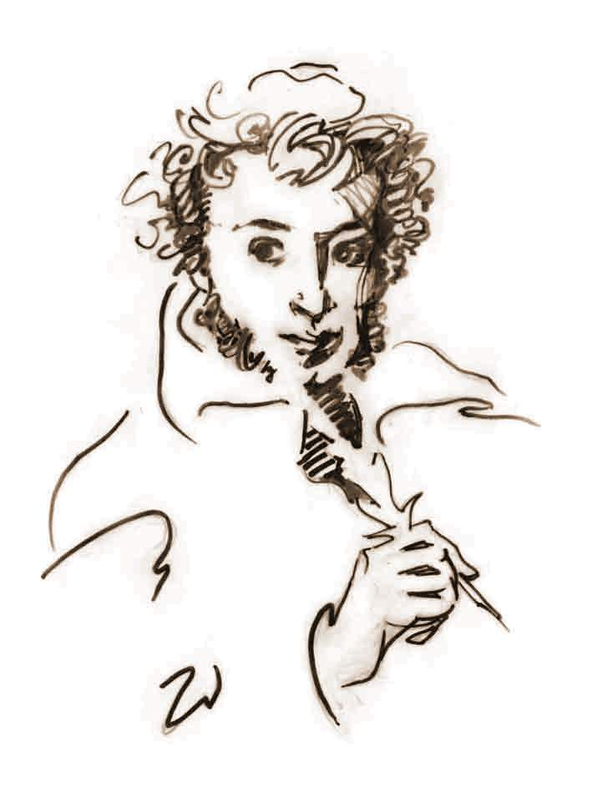
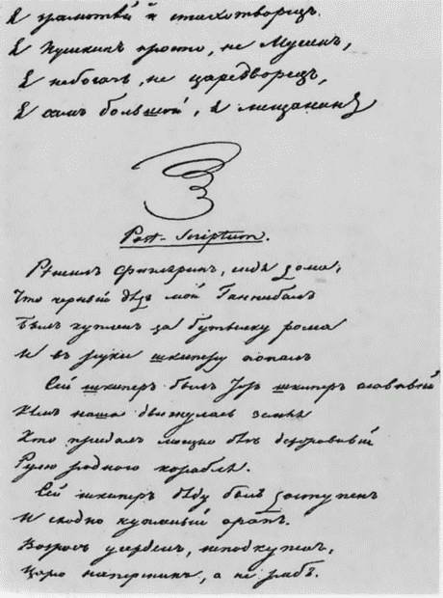
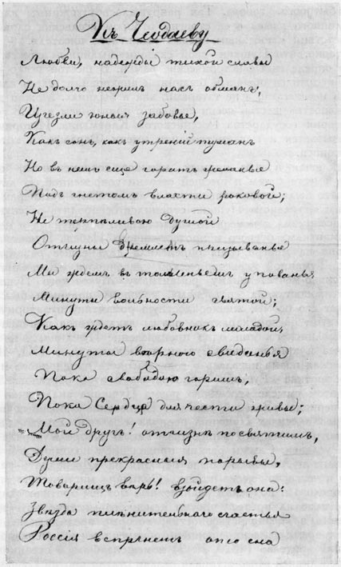

Slide 24
http://www.poetarium.info/pushkin/english.htm
https://en.wikiquote.org/wiki/Aleksandr_Pushkin
https://en.wikipedia.org/wiki/Moyka_River
http://www.m24.ru/articles/13972
http://www.abc-people.com/data/pushkin/soch2.htm
http://www.restbee.ru/guides/razvliechieniia-i-prazdniki/8-samykh-izviestnykh-pamiatnikov-a-s-pushkinu.html
https://www.stihi.ru/2009/05/07/159

