Slide 1
Do you know your address?
Митюгина Татьяна Геннадьевна
Учитель английского языка
МОУ Кокинская СОШ Брянской области
Использованные ресурсы:
Фото из личного архива
Песня http://www.ilovewavs.com

Slide 2
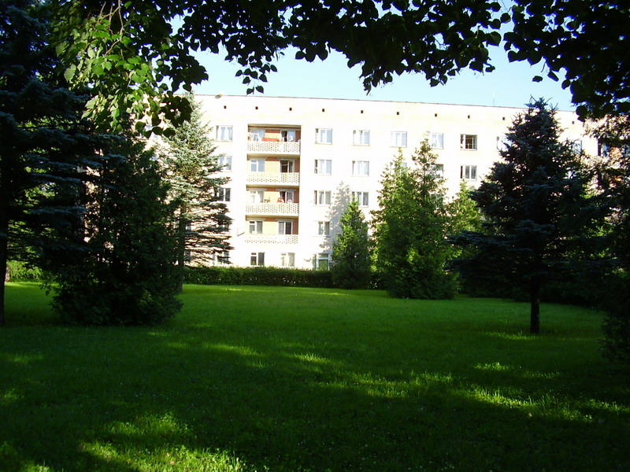
Do you know your address?
Do you know the number of the house,
the number of the house,
the number of the house,
Do you know the number of the house
the house where you live ?
Do you know the name of the street,
the name of the street,
the name of the street,
Do you know the name of the street
the street where you live ?
Do you know your address?

