Slide 1
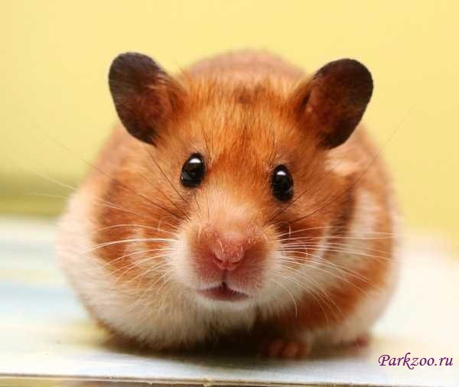
My pet
I have got a pet.
It’s a hamster.
It’s little.
It’s white and brown.
I love my pet.

Slide 2
