Slide 1
Сочинение на тему: «Я хочу стать учителем» (I want to be a teacher)

Slide 2
Выполнил: ученик школы №3, 6 «А» класса
Малин Александр

Slide 3
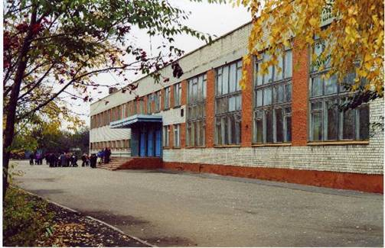
My school is a four-storied building. It is quite big with sport ground behind it. On the ground floor there are the classrooms for the pri­mary-school pupils, workshops, library. There are special classrooms for Chemistry, Physics, Biology, History, Geography, English, and Russian on the second, third, fourth stories.

Slide 4
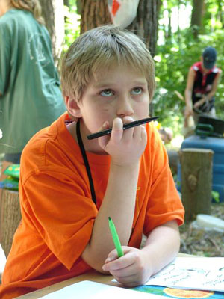
My mother often asks me one question – what I am going to be in future. I would like to become a teacher very much. It is so interesting, but it is vey difficult.

Slide 5
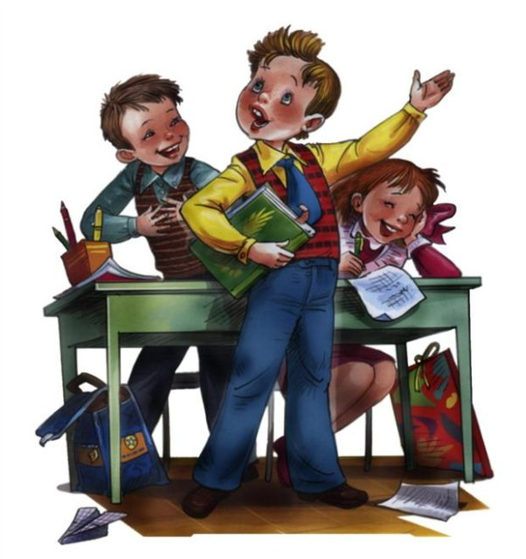
Some people think, to be a teacher is very easy. But really it is not true. When the students enter the school, their minds are empty. And it depends on the teacher, what he will put in to student’s souls.

Slide 6
If I would a teacher, I would start my lessons with a joke to cheer the children up. Best of all I desire to be a teacher of history.

Slide 7
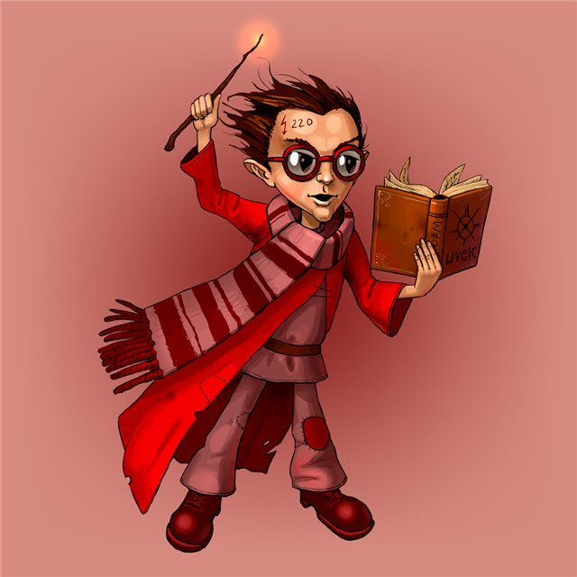
To my mind, every child must know the history of his Motherland. In order to understand every child’s soul, I would include the lesson of fantasy. I would never get a bad mark, if the home task is not done.

Slide 8
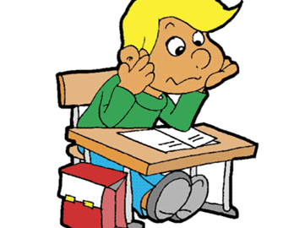
I would like to give a student the second chance to correct his mistakes. The child must not be afraid of going to school. My best wish is that every child would strive for knowledge.

Slide 9
In conclusion, I like to say that it is very difficult to say, what the real teacher must be.

Slide 10
In this text I have expressed my opinion on this problem. May be it is not correct, but it is my mind!

