Slide 1
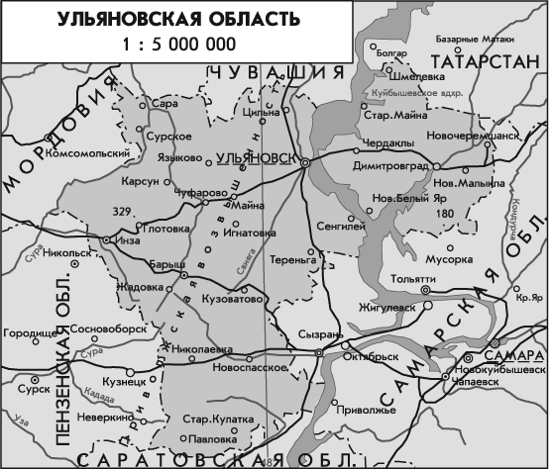
Sightseeng of Terenga Ulyanovsk region
BOTTOMLESS
English teacher
Nataliya Kochetcova

Slide 2
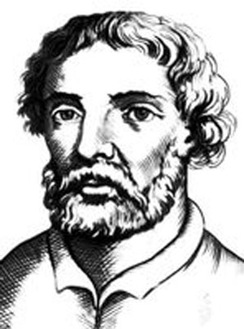
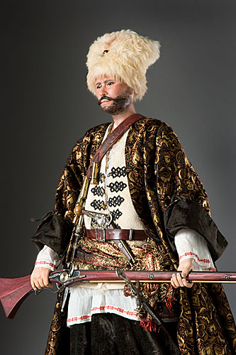
From history
After defeat of bands of Stenka Razin daring robbers have lodged in local woods. They plundered orthodox and other merchants on main road. They hid their good in the forest near the river. And then they have suddenly stopped to lodge.

Slide 3
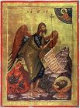
It is connected with the wonderful phenomenon in a
spring of an icon of
Ioan Predtechi.

Slide 4
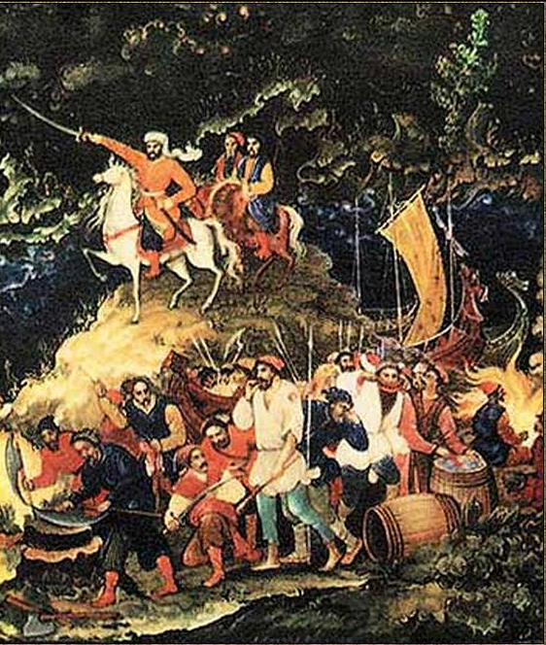
On that place where the predatory nest was, gardens have planted also church have put.
Stenkin’s robbers became peasants.

Slide 5
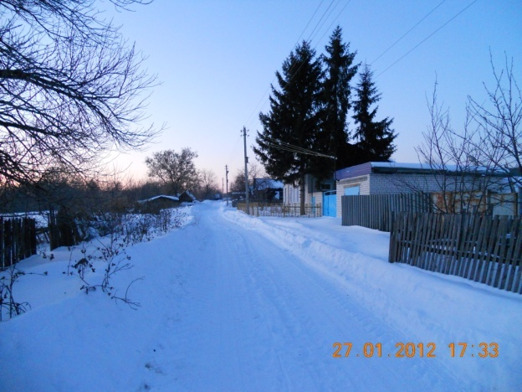
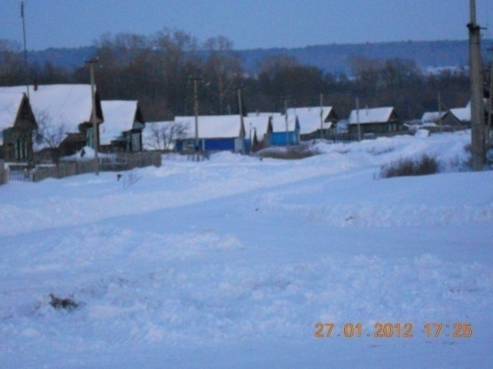
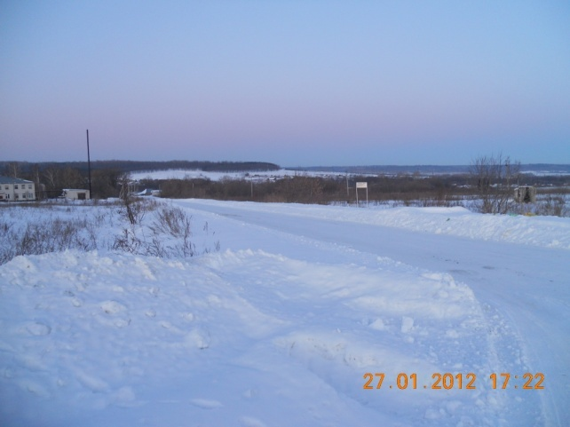

Slide 6
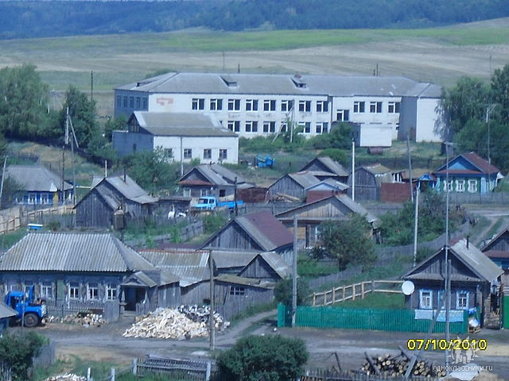
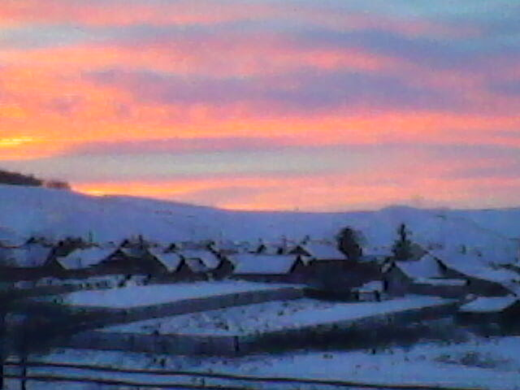
The rob Baidulka founded the village Baidulino.

Slide 7
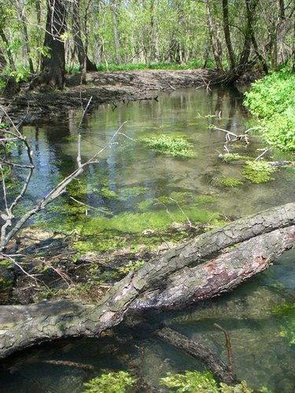
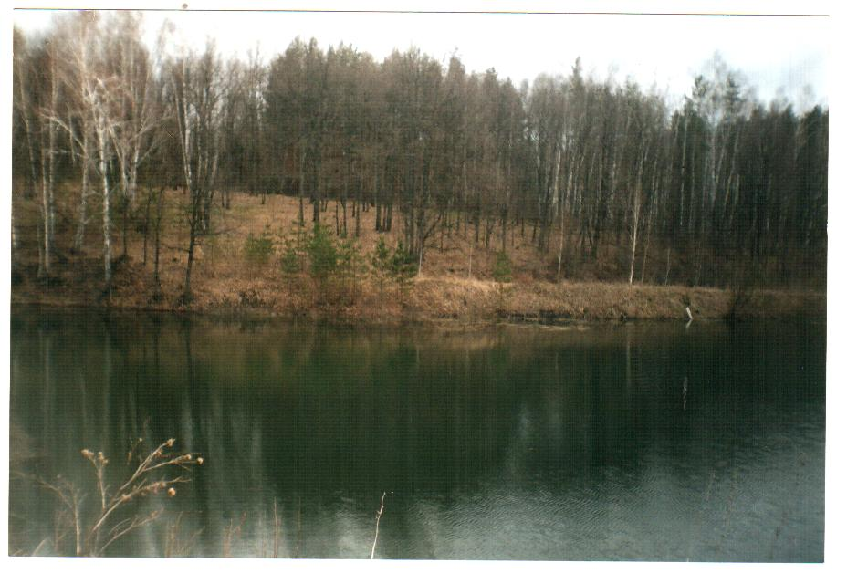
Bottomless.
In a several years men want to depth of a source. They connected three reins and two pound weight and began to depth. But reins came to end. So this source was called bottomless. It is located in the river Baramitka.

Slide 8
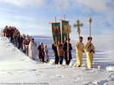
Once during service as if the earth was opened wide-church, full to the people, began to leave under water! The people have had no time to jump out and escape, and the father has sunk. On a place of a temple the key began to gush forth.

Slide 9
This place is gloomy but esteemed. Old men tell to children story about the church which has left under water in this place. Some of youth come here to listen bell’s clink. And they hear it!

Slide 10
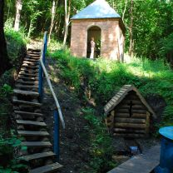
The local timber enterprise suited a font here. They have constructed short flights of stairs and bedrails.

Slide 11
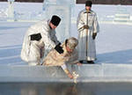
The Molvino’s priest has shined a small chapel.

Slide 12
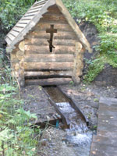
But the majority of people visit the Bottomless because there is miracle water. It is tasty and curative.

Slide 13
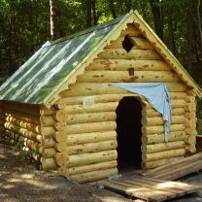
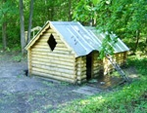
This font is constructed many years ago in this place.

Slide 14
This font is constructed recently.

Slide 15
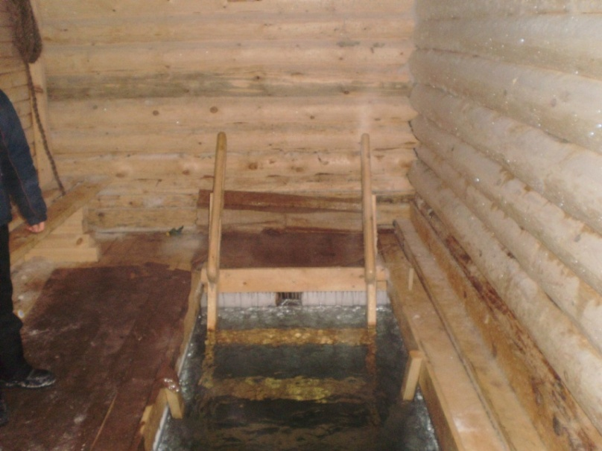
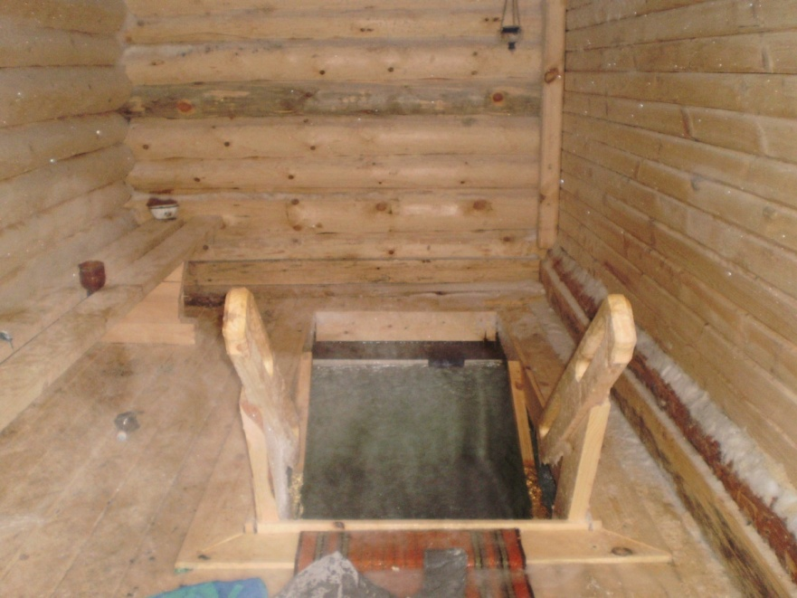
Man’s font
A font for woman

Slide 17
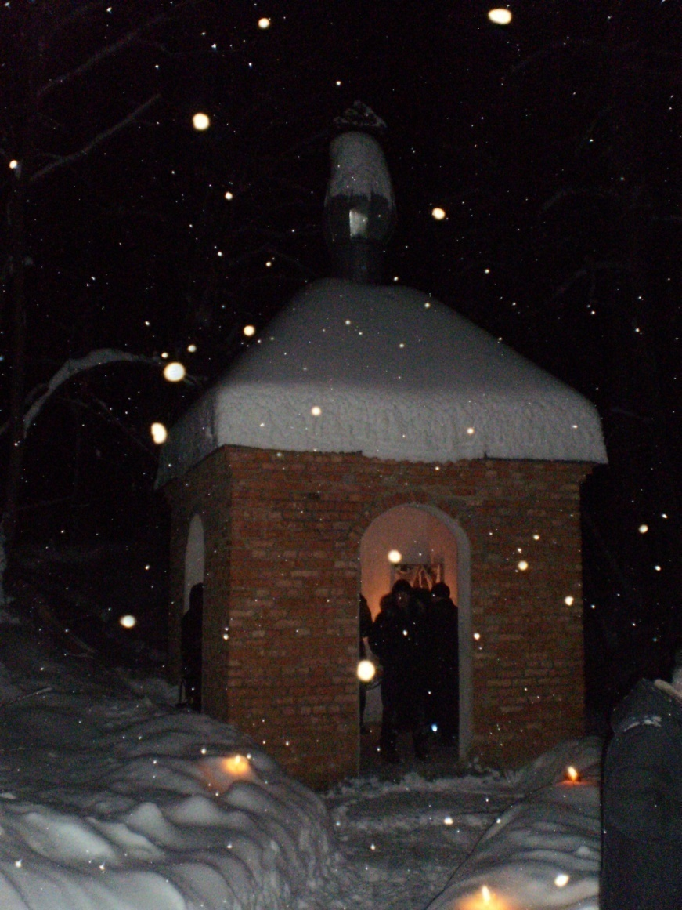
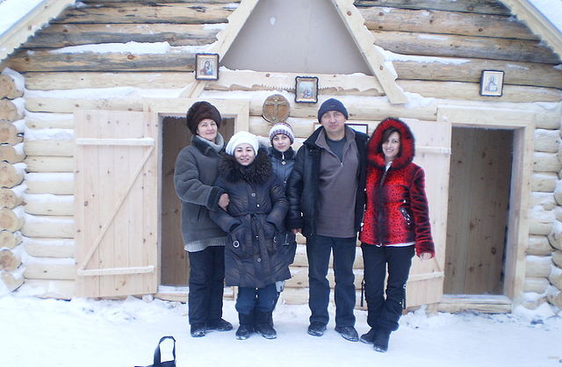
Now here it is crowded. For the Christening, in Spirits day buses with pilgrims come.

Slide 18
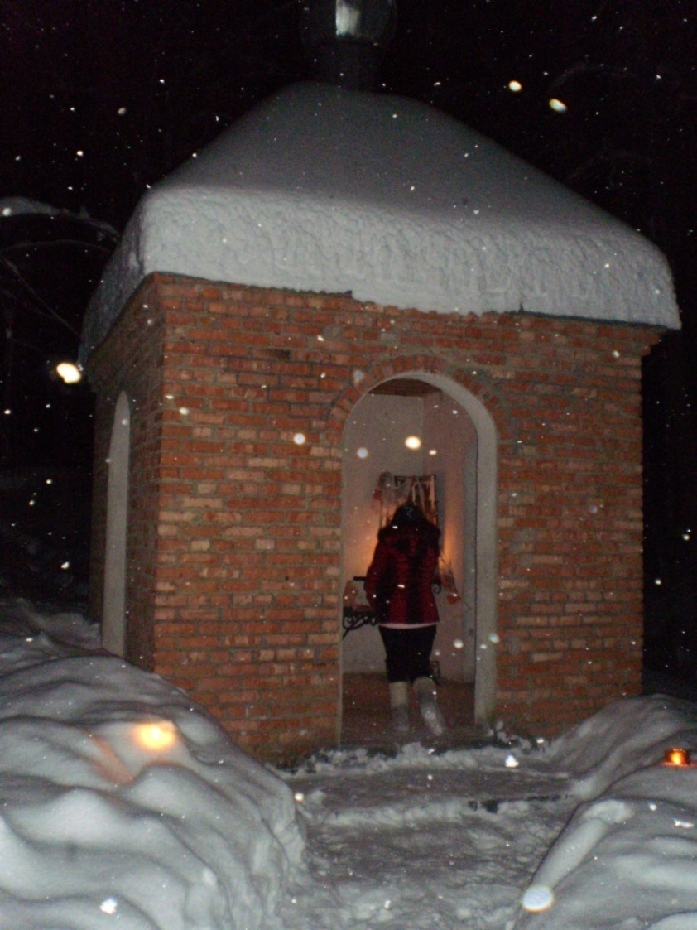
People have learned to heal themselves.

Slide 19
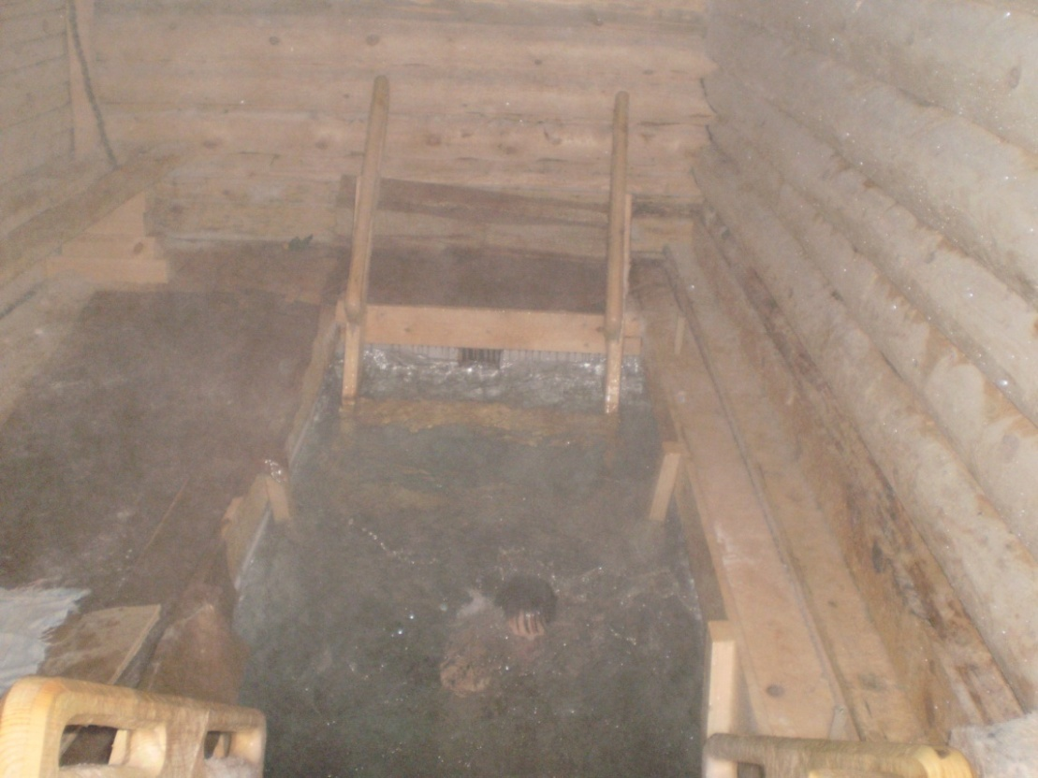
If you dive with belief and a prayer three times your illness will depart.

Slide 20
Saveliev’s family come here every year

Slide 21
Welcome to our BOTTOMLESS
Thank you for your attention !

