Slide 1
Sightseeng of Terenga
Anastasia Frolova
Maria Pleshkova
Farida Abdualimova,
Grade 11

Slide 2
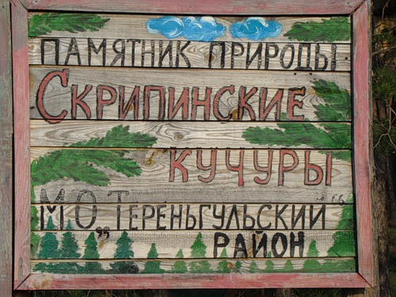
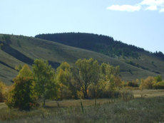
Skripino’s Kuchuri.
The stone forest is located 5 km from the village of Mikhailovka in Valley Ridge Kuchuri. Mountains stretched out on the two hundred miles and they are well visible from the road. These stones have appeared during the formation of the Earth's surface for nearly 30 million years ago. They have taken unusual forms under the influence of wind and water over the years.
Skripino’s Kuchuri is a monument of nature.
The stone forest is located 5 km from the village of Mikhailovka in Valley Ridge Kuchuri. Mountains stretched out on the two hundred miles and they are well visible from the road. These stones have appeared during the formation of the Earth's surface for nearly 30 million years ago. They have taken unusual forms under the influence of wind and water over the years.

Slide 3
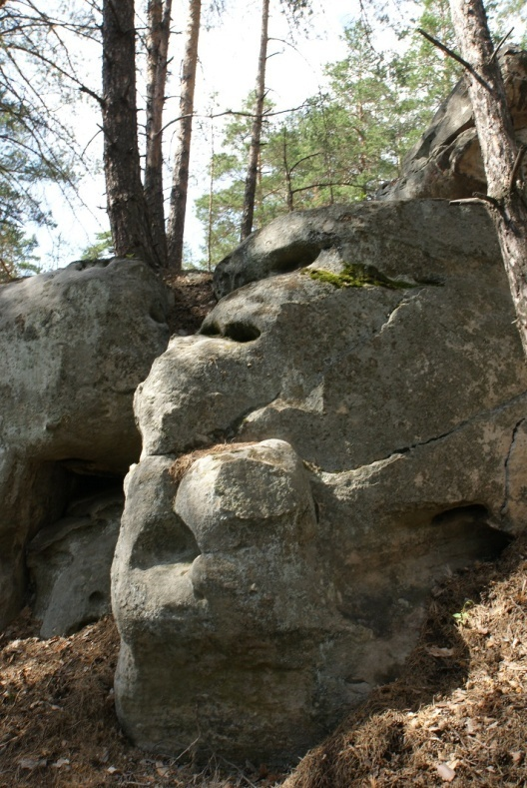
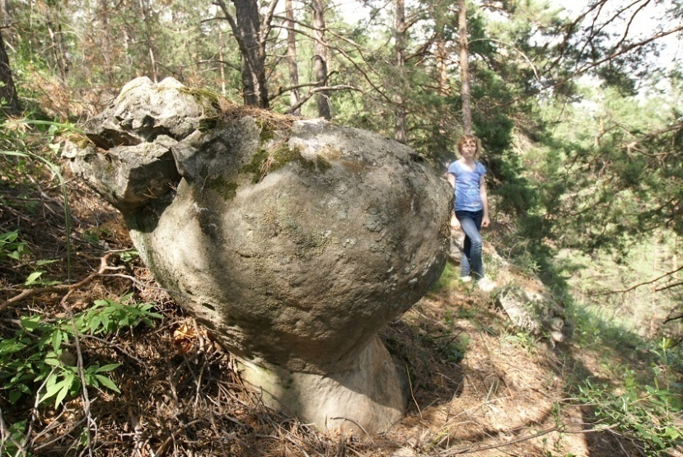
In the forest near the village of Mikhaylovka there are many blocks of stone, resembling the shape of animals: horses, cows and even frog. What is it? Freaks of nature
or the product of man?

Slide 4
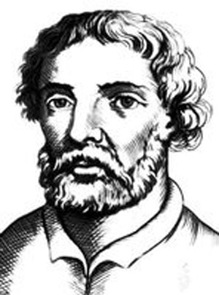
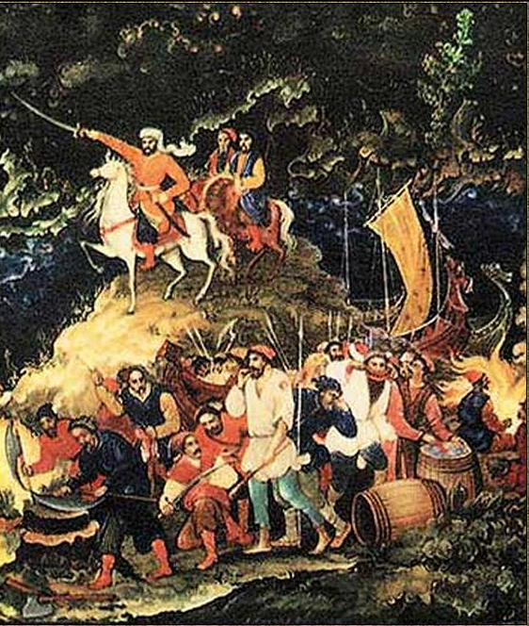
From history
.. It is believed that Stepan Razin hid in Kuchura and he buried a treasure here. People who lived here
will show you a
"headquarters"
of the famous robber..

Slide 5
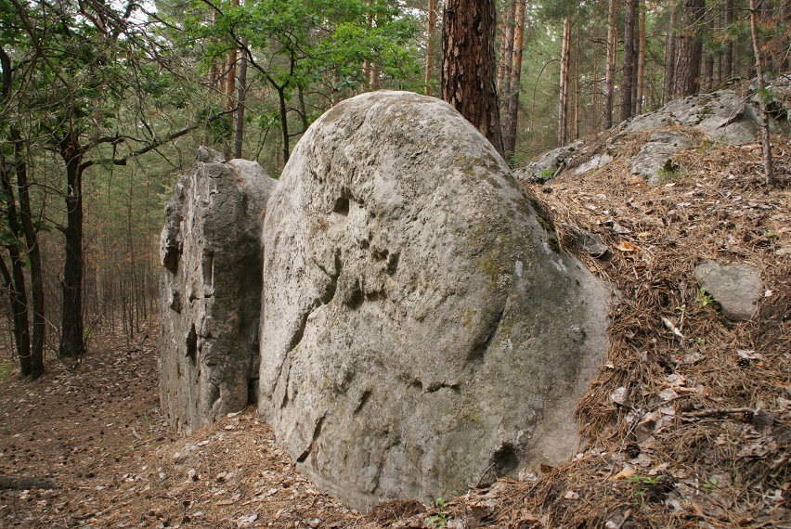
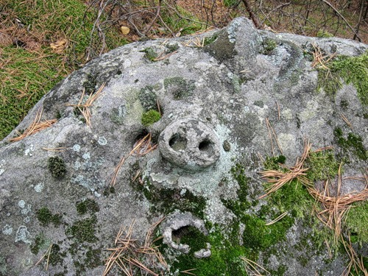
Kuchura is an ideal place for relaxing. What there is the heady scent of pine!

Slide 6
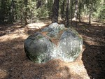
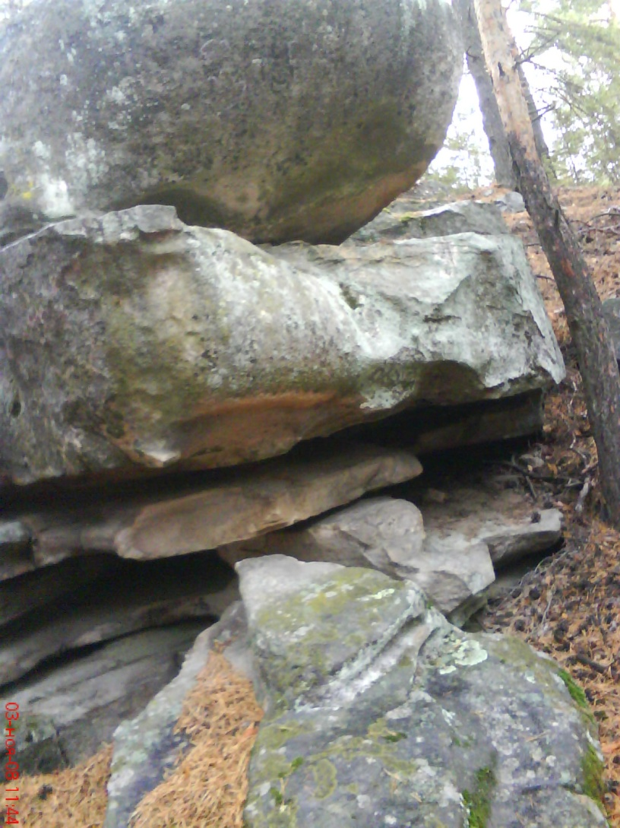
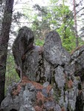
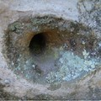
Mistery figures

Slide 7
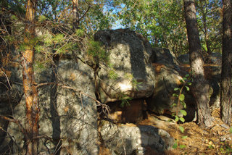
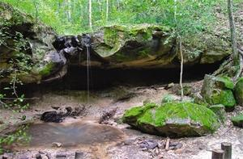
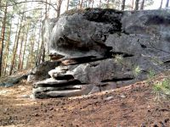
Different forms of stones
you can see in this place

Slide 8
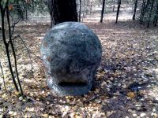
A Head
It is said that this stone heals headaches, high blood pressure and migraine. You should put your hands on a block. Perhaps someone would think that a head can to speak.

Slide 9
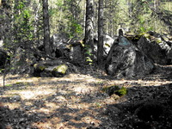
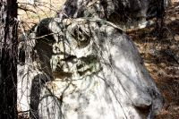
A Horse
It is considered that if
this stone is watered the
rain will go. Till now
someone brings there
gifts, wood nuts, and
sometimes even bread.
An Owl

Slide 10
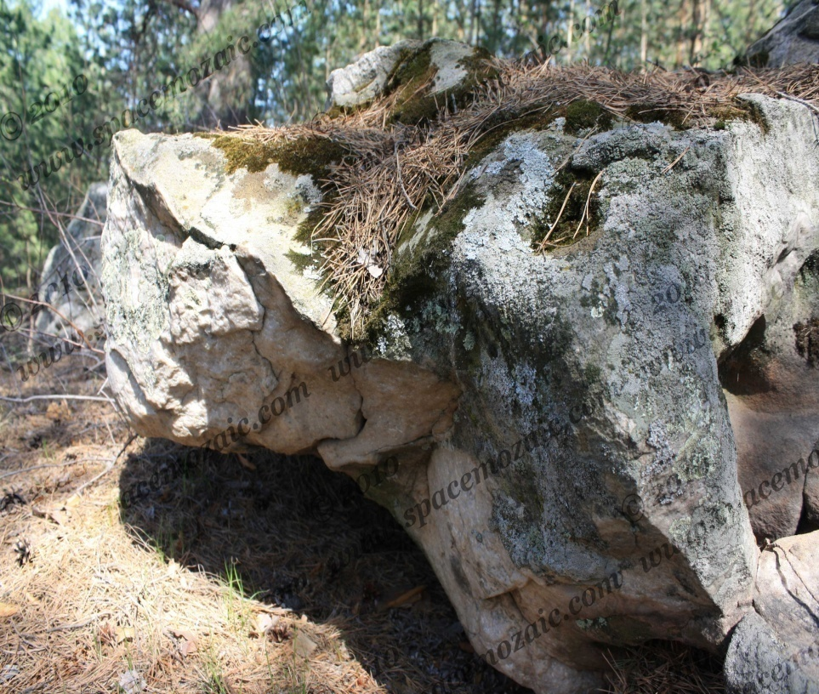
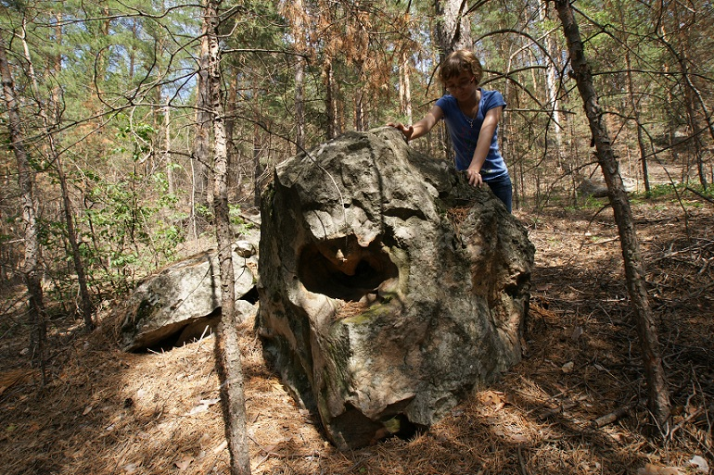
A crocodile?

Slide 11
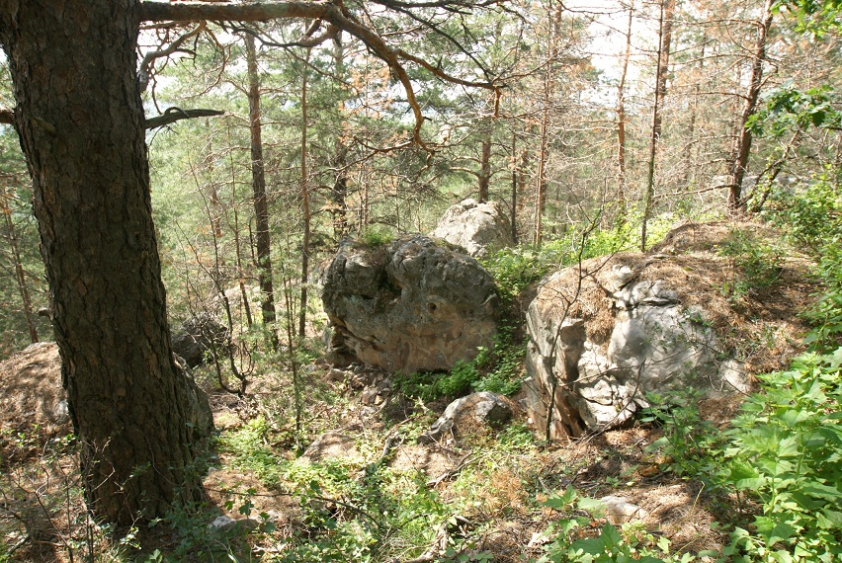
A Tortoise

Slide 12
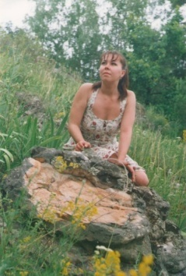
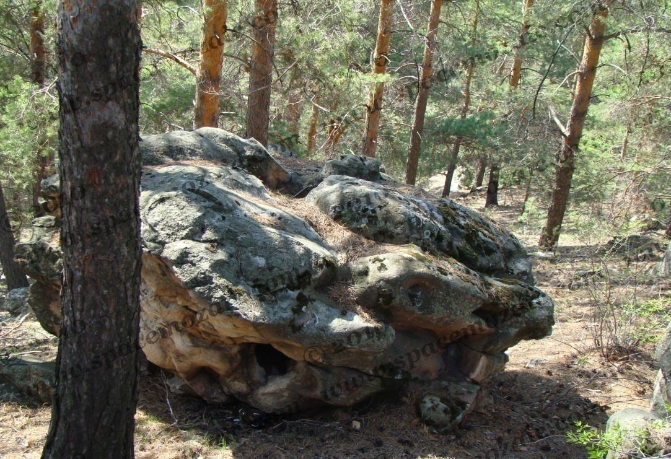
a Frog
One of the stones is very similar to hidden in the grass frog.
Villagers were told that you make a wish here. You must rub "frog" back.

Slide 13
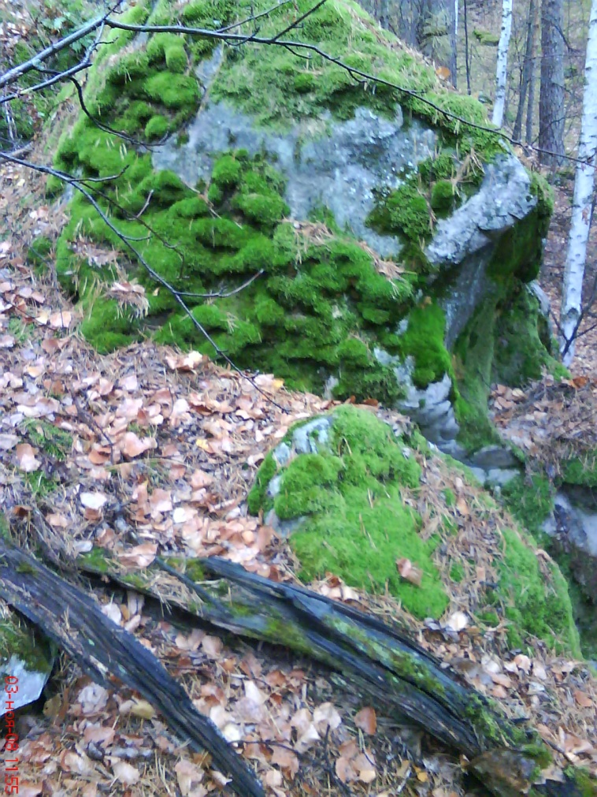
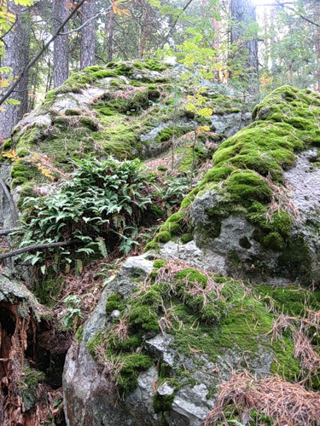
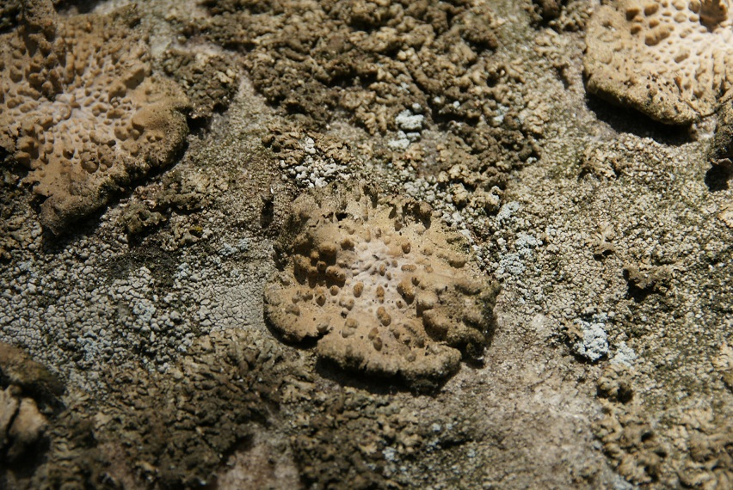
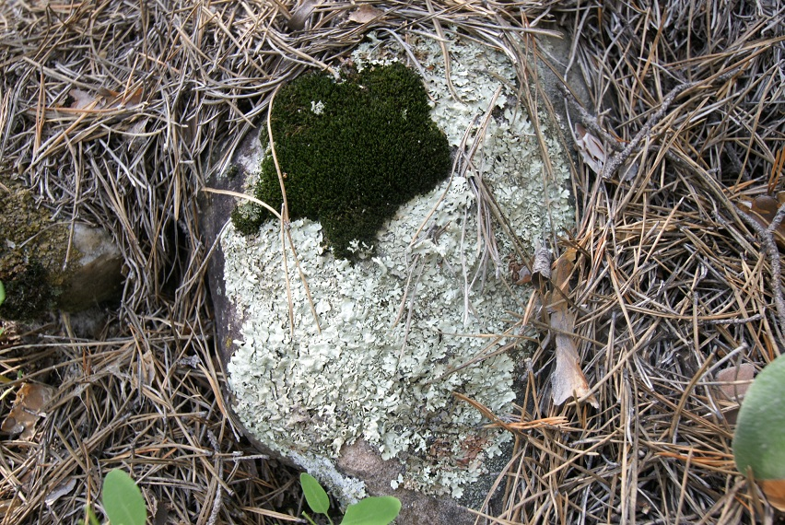
Unique species of ferns, mosses and lichens was found in this place. In the forest there is a sand, which is very similar to the sea one. Perhaps Kuchura was the sea floor millions years ago?

Slide 14
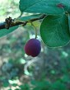
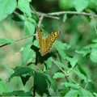
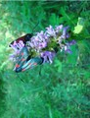
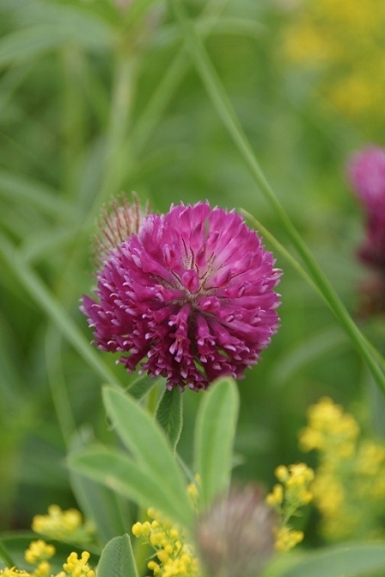
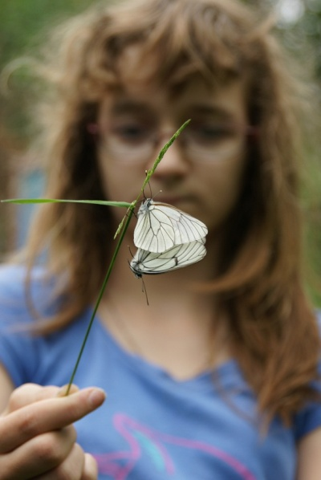
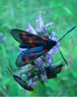
Living thing
There are differents kind of butterflies and a lot of flowers here.

Slide 15
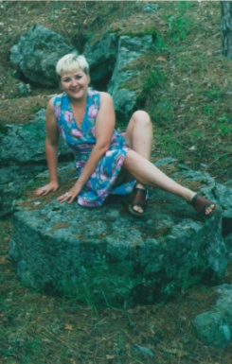
Another opinion
It is said that giants lived here. There were found traces of their presence on the ground.
Manuscripts of living on the banks of the Volga giants first appeared in 992. An arab diplomat Ahmad ibn Fadlan was the author of this manuscripts.
«This is tables and chairs for giants», - said old people.

Slide 16
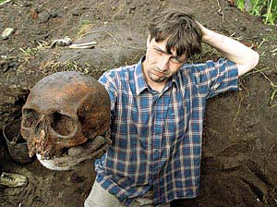
Alexander Markelov, a pensioner from Mikhaylovka, said journalists how he was a personally witness of how the great stone was founded in the garden. A bulldozer accidentally dug up the bones of giant men when 60-years pensioner
planned to dig his cellar
near his house.

Slide 17
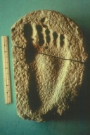
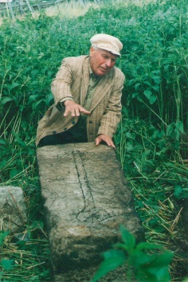
Alexander Markelov, a pensioner from Mikhaylovka, said journalists how he was a personally witness of how the great stone was founded in the garden. A bulldozer accidentally dug up the bones of giant men when 60-years pensioner planned to dig his cellar near his house.
Alexander Markelov, a pensioner from Mikhaylovka, said journalists how he was a personally witness of how the great stone was founded in the garden. A bulldozer accidentally dug up the bones of giant men when 60-years pensioner planned to dig his cellar near his house.
And, indeed, about 20 meters
from the house, in the thickets of
grass were three large rectangular
platys. One or two meters long and
weights of two feet. On the stone
a cross was carved. On the other
side of this stone there were
some signs.
There was a carved inscription.
49 sm bone was founded there.

Slide 18
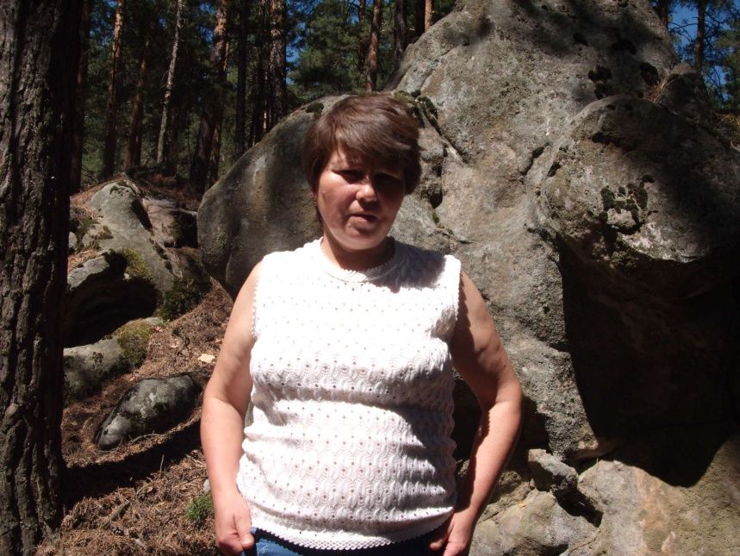
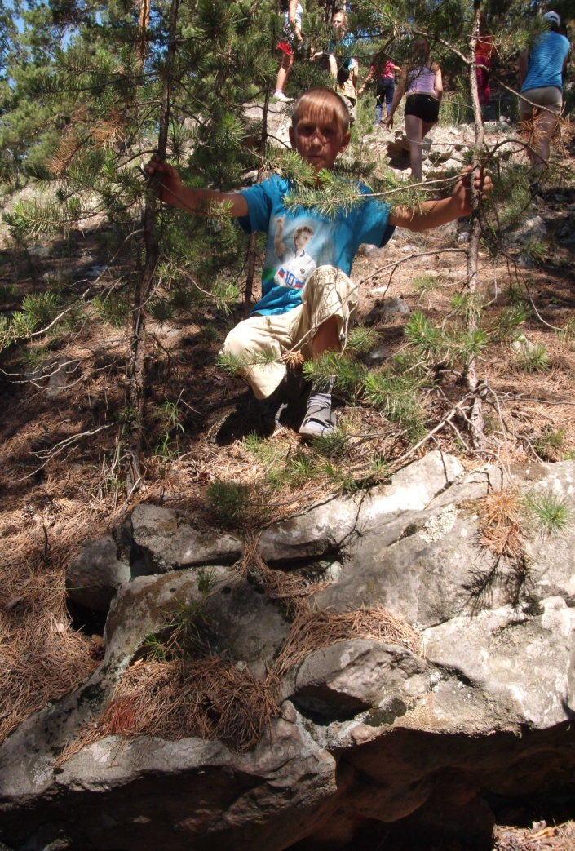
Pupils from our school visited this place at once

Slide 19
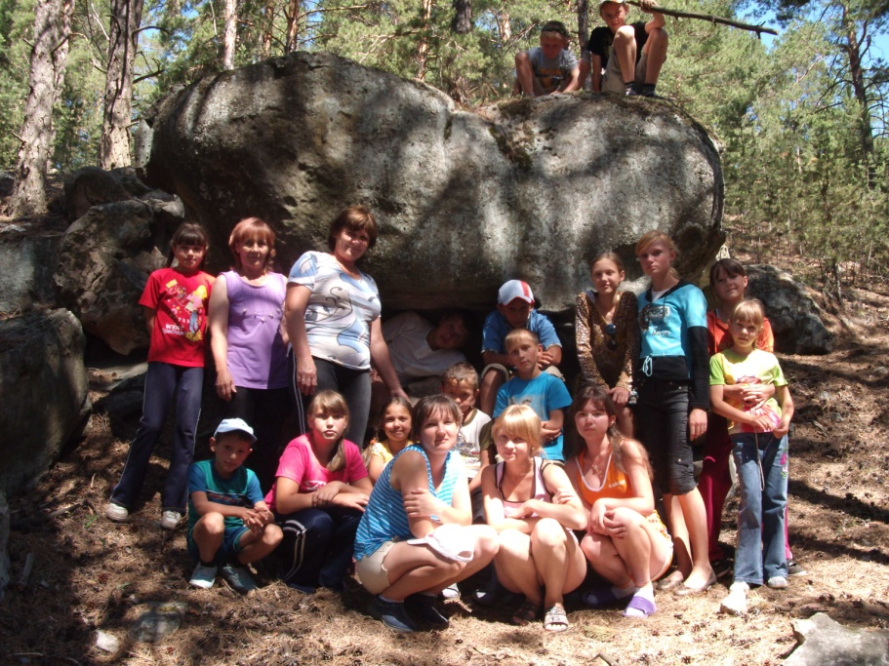
We liked this place very much

Slide 20
Welcome to Skripino’s Kuchuri.
Enjoy your visiting!

