Slide 1
Do you know symbols of Great Britain?

Slide 2
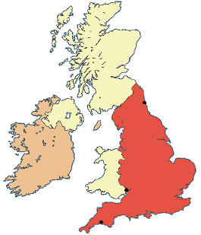
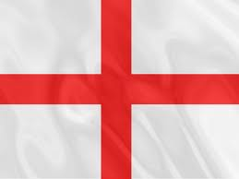
What colour is it?
This is the map of England.
And this is the flag of England.

Slide 3
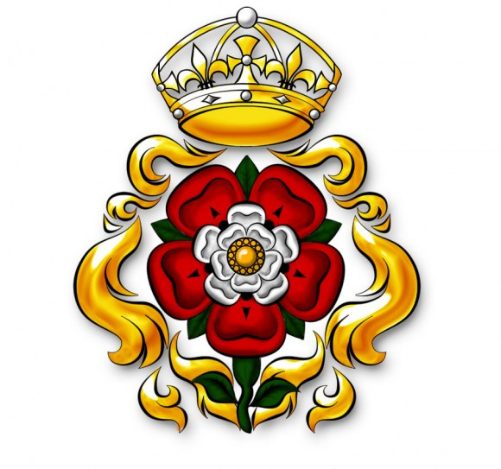
Red rose is the symbol of England.
The capital of England is London.

Slide 4
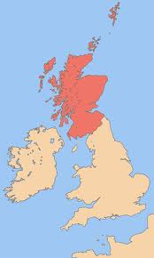
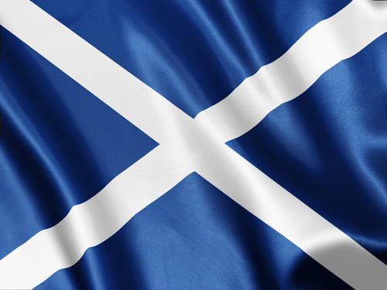
What colour is the flag?
This is Scotland.
This is the flag of Scotland.

Slide 5
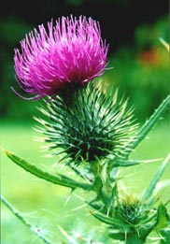
Thistle is the symbol of Scotland.
Edinburg is the capital of Scotland.

Slide 6
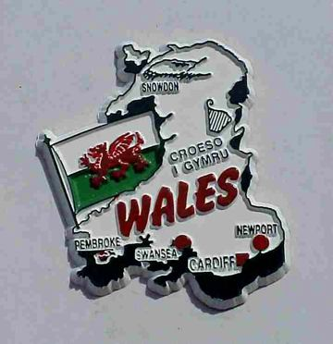
What colour is the flag?
You can see Wales and its flag.

Slide 7
Leek and daffodil are the symbols of Wales.
Cardiff is the capital of Wales.

Slide 8
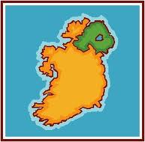
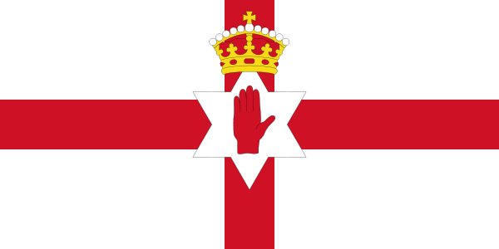
What colour is Northern Ireland?
Northern Ireland.
This is the flag of Northern Ireland.

Slide 9
Shamrock is the symbol of Northern Ireland.
Belfast is the capital of Northern Ireland.

Slide 10
London is the capital of Great Britain.
This is the flag of Great Britain. Its name is Union Jack.

Slide 11
CONGRATULATIONS!!!
Answer the questions.
1. What is the symbol of England? Scotland? Wales? Northern Ireland?
What is the capital of Great Britain?
What is the name of the flag in Great Britain?
What colour is the flag in Scotland?
What animal can you see on the flag of Wales?

