Slide 1
The World around me.
Выполнила Каропчук Дана.
Школа№3 класс 4а

Slide 2
My mum
When I was born I saw my mum. She looked at me with her kind eyes.
Everything around me was very frightening but my mum took me and gave me a warm hug. I felt that everything will be very good.

Slide 3
My school.
My school is very large and new. It is only 3 years old. I like it very much as there are lot of clubs. I study at English club “At the Fireplace”, dancing club and choir.
I study at the music school and learn playing the accordion.

Slide 4
My classmates.
There 25 students in my class. We are friendly and helpful. We love our teachers. My classmates are really good friends.

Slide 5
My favorite school subject.
My favorite school subject is English.
I study hard to learn it. I take part in contests. Last year I took part in the Krasnoyarsk territory Olympiad.
I like reading English books.
We exchange Christmas cards and toys with children from different countries.
We skyped with students of the USA school. I enjoy speaking English.

Slide 6
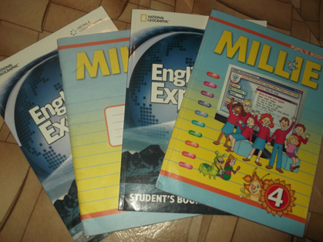
My school things.
All my school things are my helpers and I take care of them. So they are clean and beautiful.

Slide 7
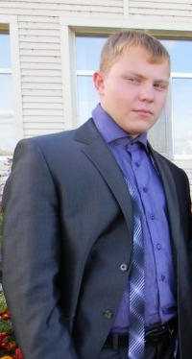
My friend.
My best friend is my brother. His name is Ruslan. He is a student of the 11 class. He is reliable and true friend. He can always give a helping hand. Ruslan plays the guitar, writes poems. I am proud of him.

Slide 8
my favorite day .
My birthdays is my favorite day.
I have many presents from my friends and relatives. We bake a cake with mum.
We prepare a special dinner for the day.
I have a party with games, dances and singing

Slide 9
My favorite toy.
This is my favorite toy. It’s a teddy bear. Its name is Mickey. My brother gave me it for my last birthday.
I love my teddy. I do my homework and read books sleep with it.

Slide 10
My favorite season.
My favorite season is summer.
I like swimming, sunbathing, walking in the forest.

